Slide 1
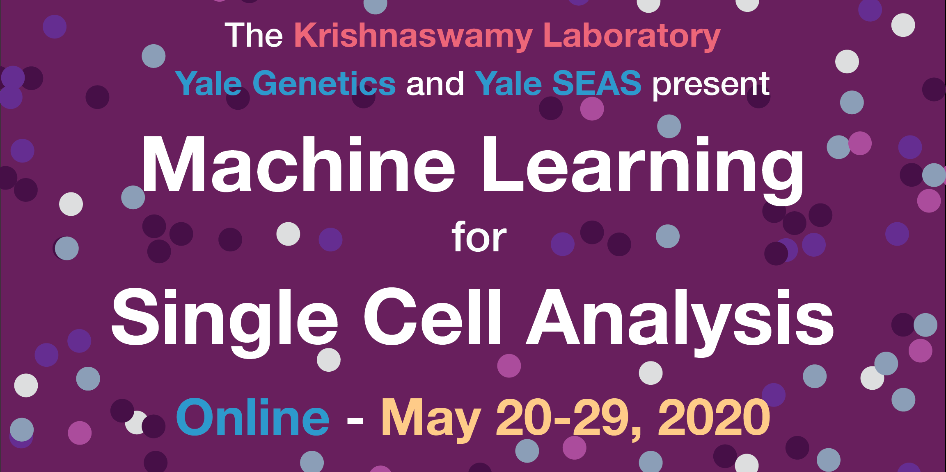

Slide 2
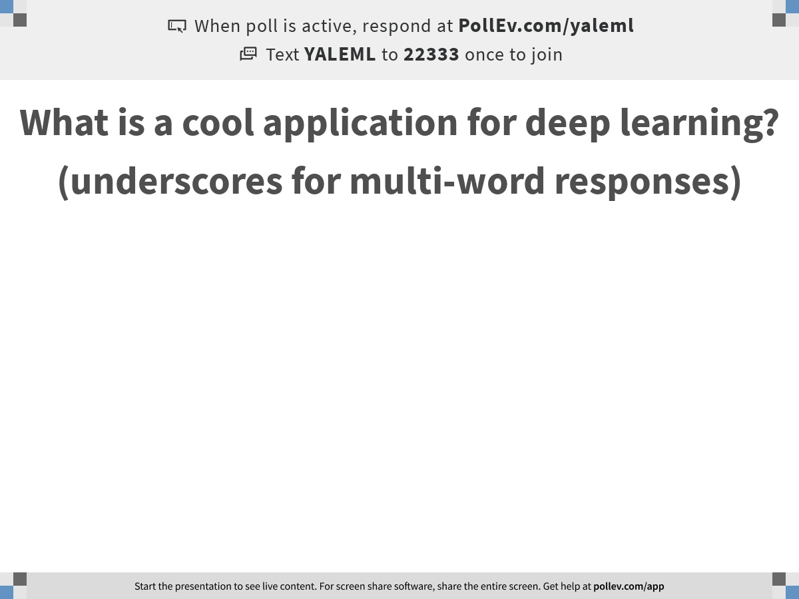
Notes:
What is a cool application for deep learning? (underscores for multi-word responses)
https://www.polleverywhere.com/free_text_polls/3qd7wqefwOqdnE8PrJqf5

Slide 3

Recap of Clustering, Trajectories, Gene relationships
Notes:
TA introduction
Talk about not teaching code (not a programming workshop)

Slide 4
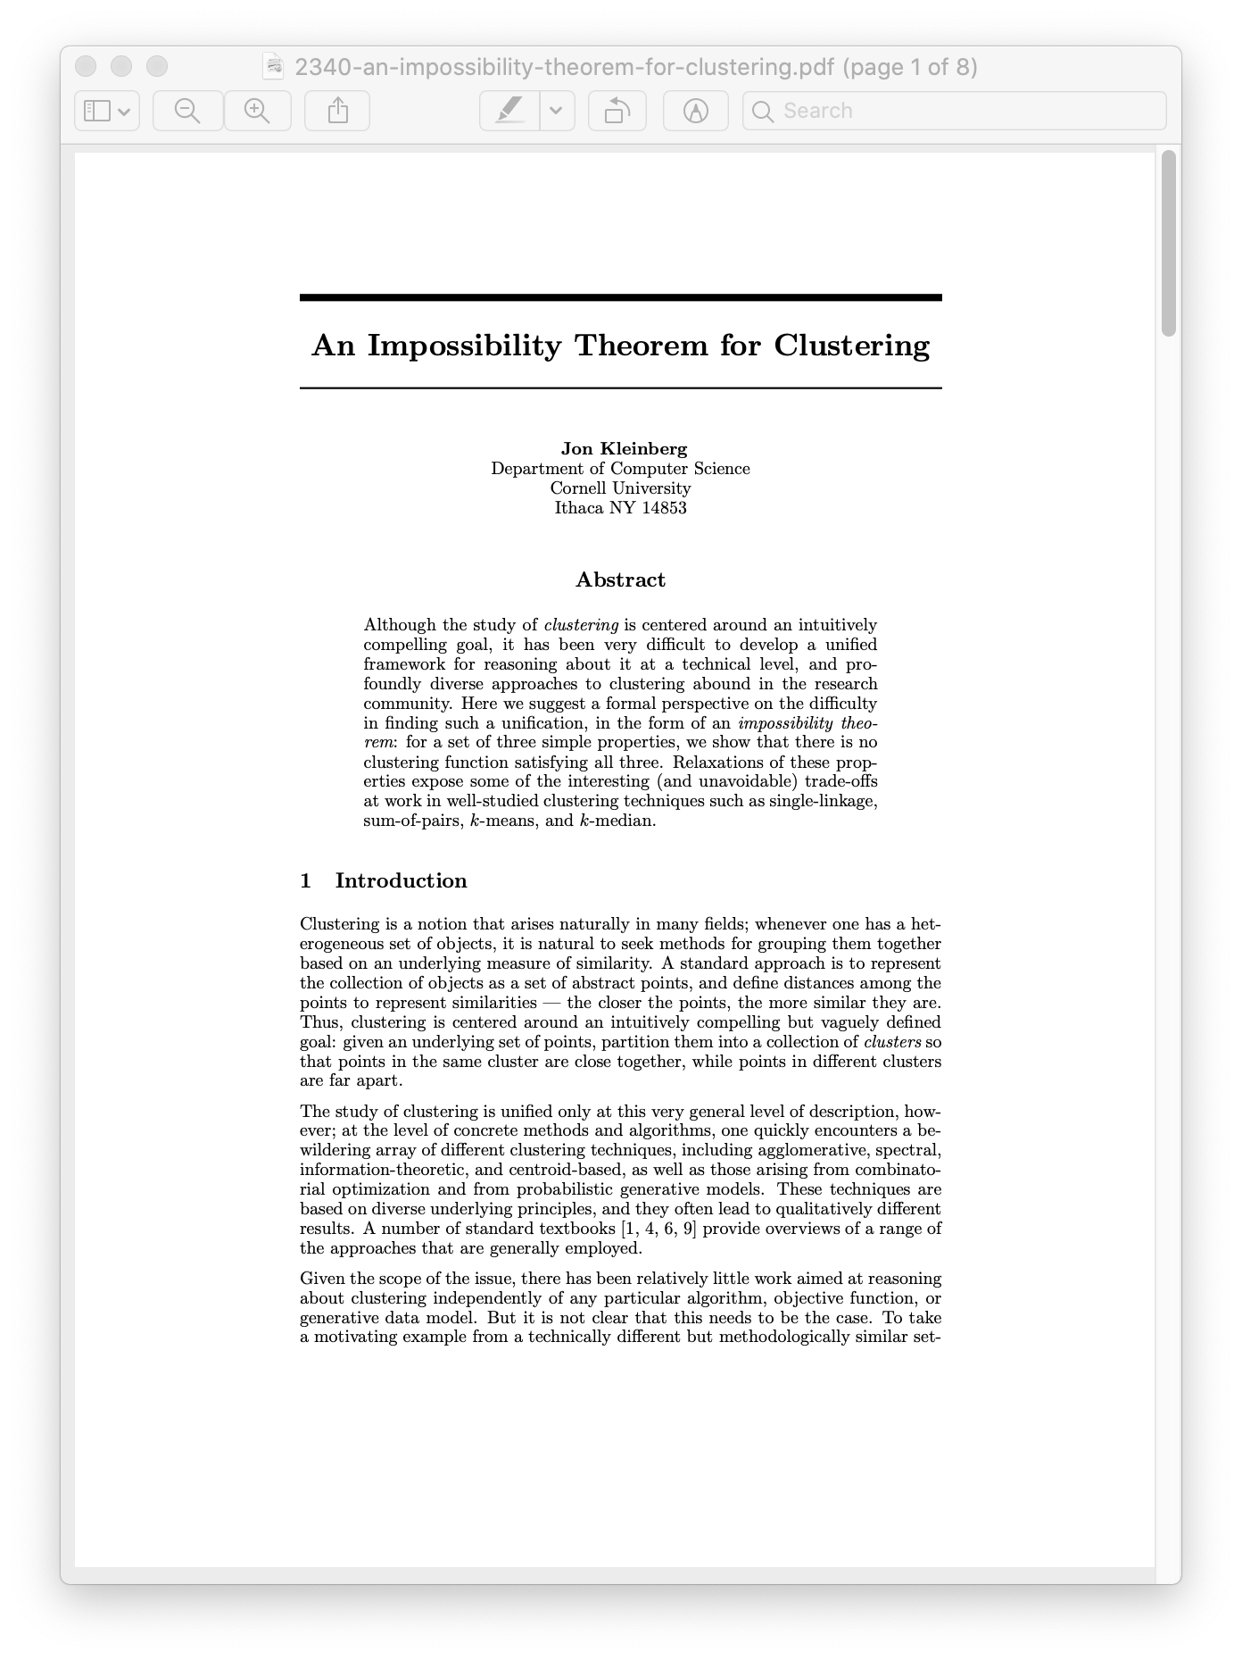
Kleinberg (2002)

Slide 5
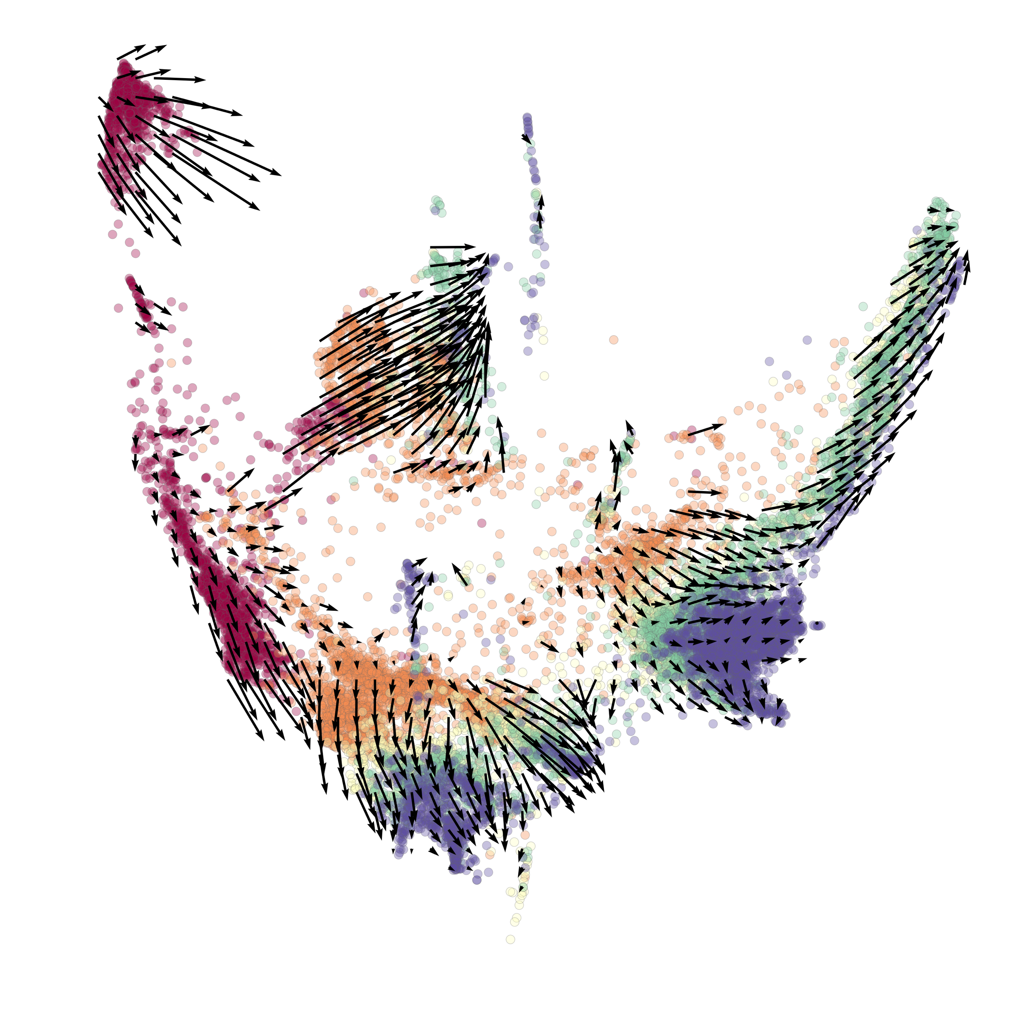
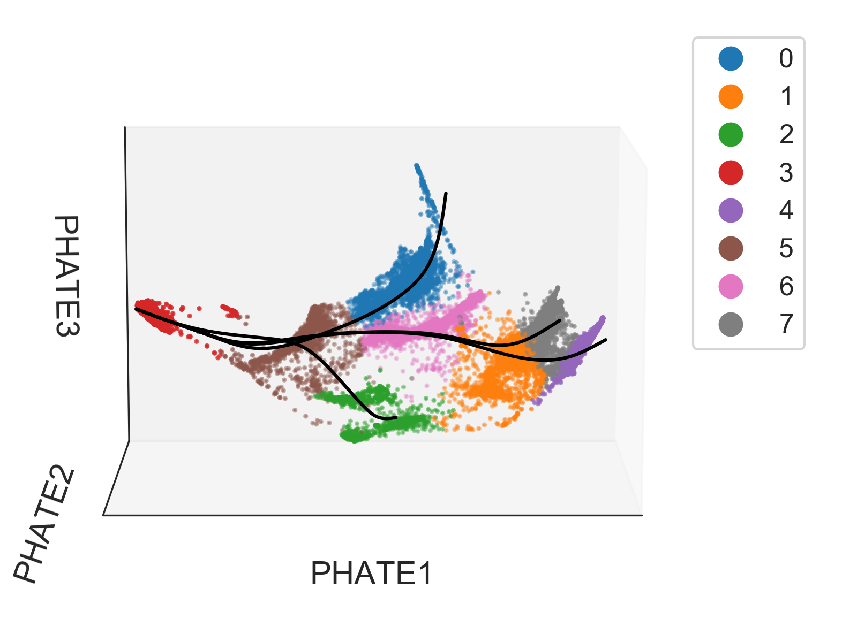
RNA velocity assists selection of root cell and endpoints

Slide 6
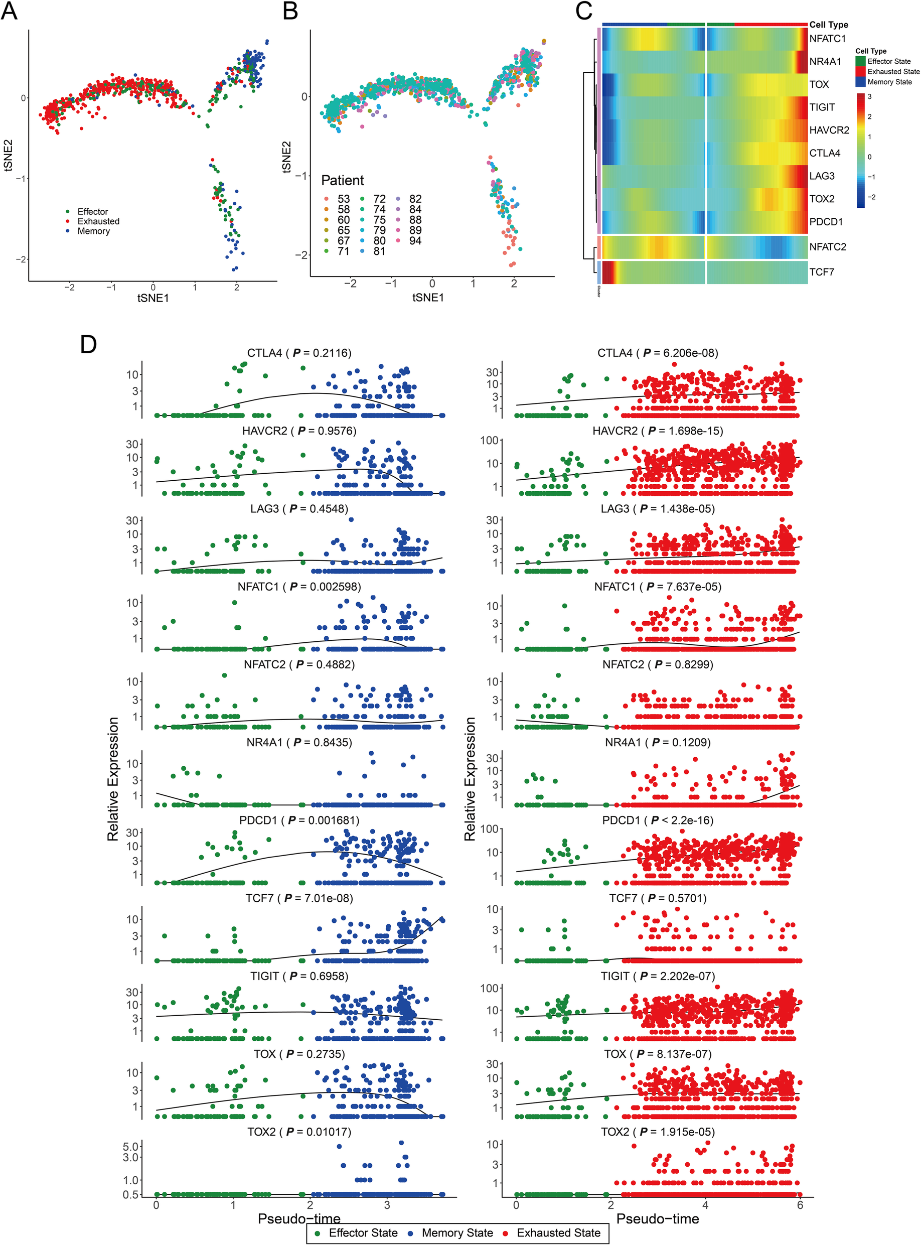
Pseudotime is not time series analysis
Kim et al. Genome Medicine (2020)
https://doi.org/10.1186/s13073-020-00722-9

Slide 7
Pseudotime is not time series analysis
Kim et al. Genome Medicine (2020)
https://doi.org/10.1186/s13073-020-00722-9

Slide 8
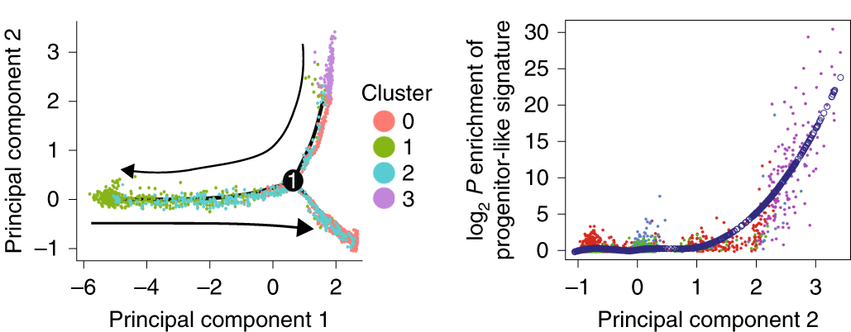
Pseudotime is not time series analysis
Yao et al. Nature Immunology (2019)
https://doi.org/10.1038/s41590-019-0403-4

Slide 9
Challenges in inferring cell state dynamics from snapshots
Weinreb et al. PNAS (2018)
https://doi.org/10.1073/pnas.1714723115

Slide 10
Challenges in inferring cell state dynamics from snapshots
Weinreb et al. PNAS (2018)
https://doi.org/10.1073/pnas.1714723115

Slide 11
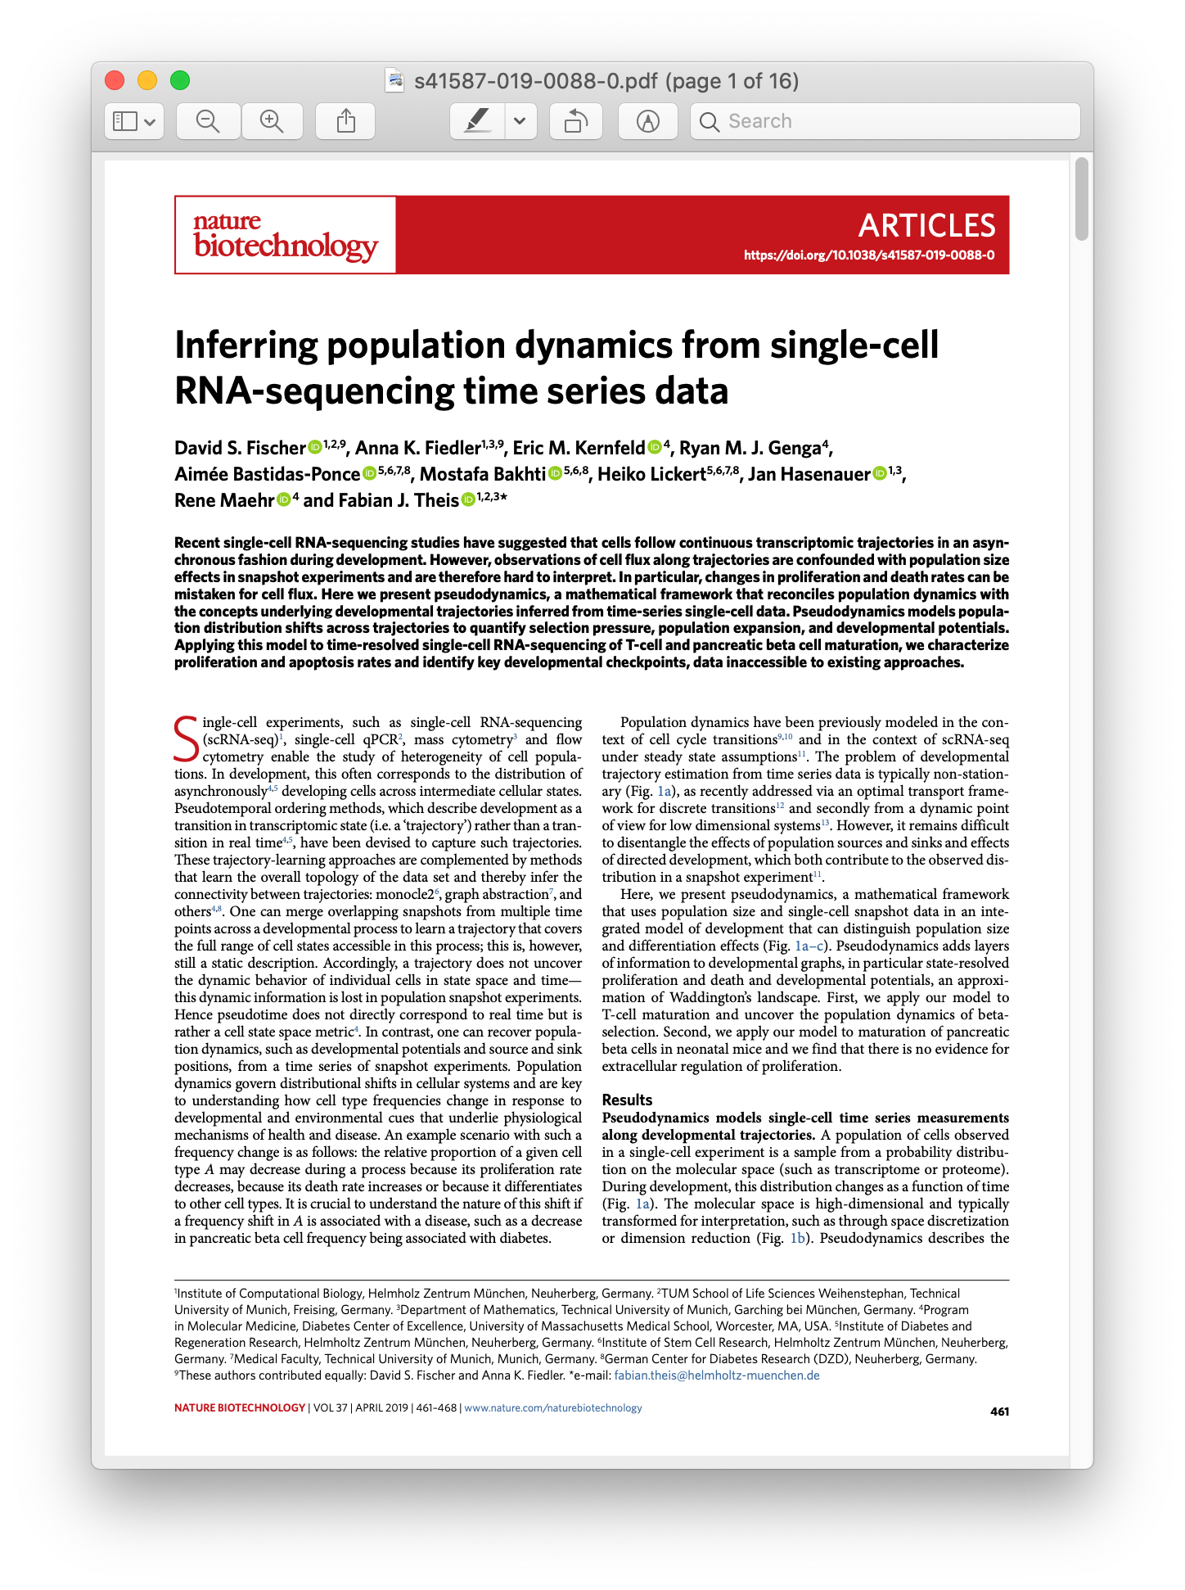
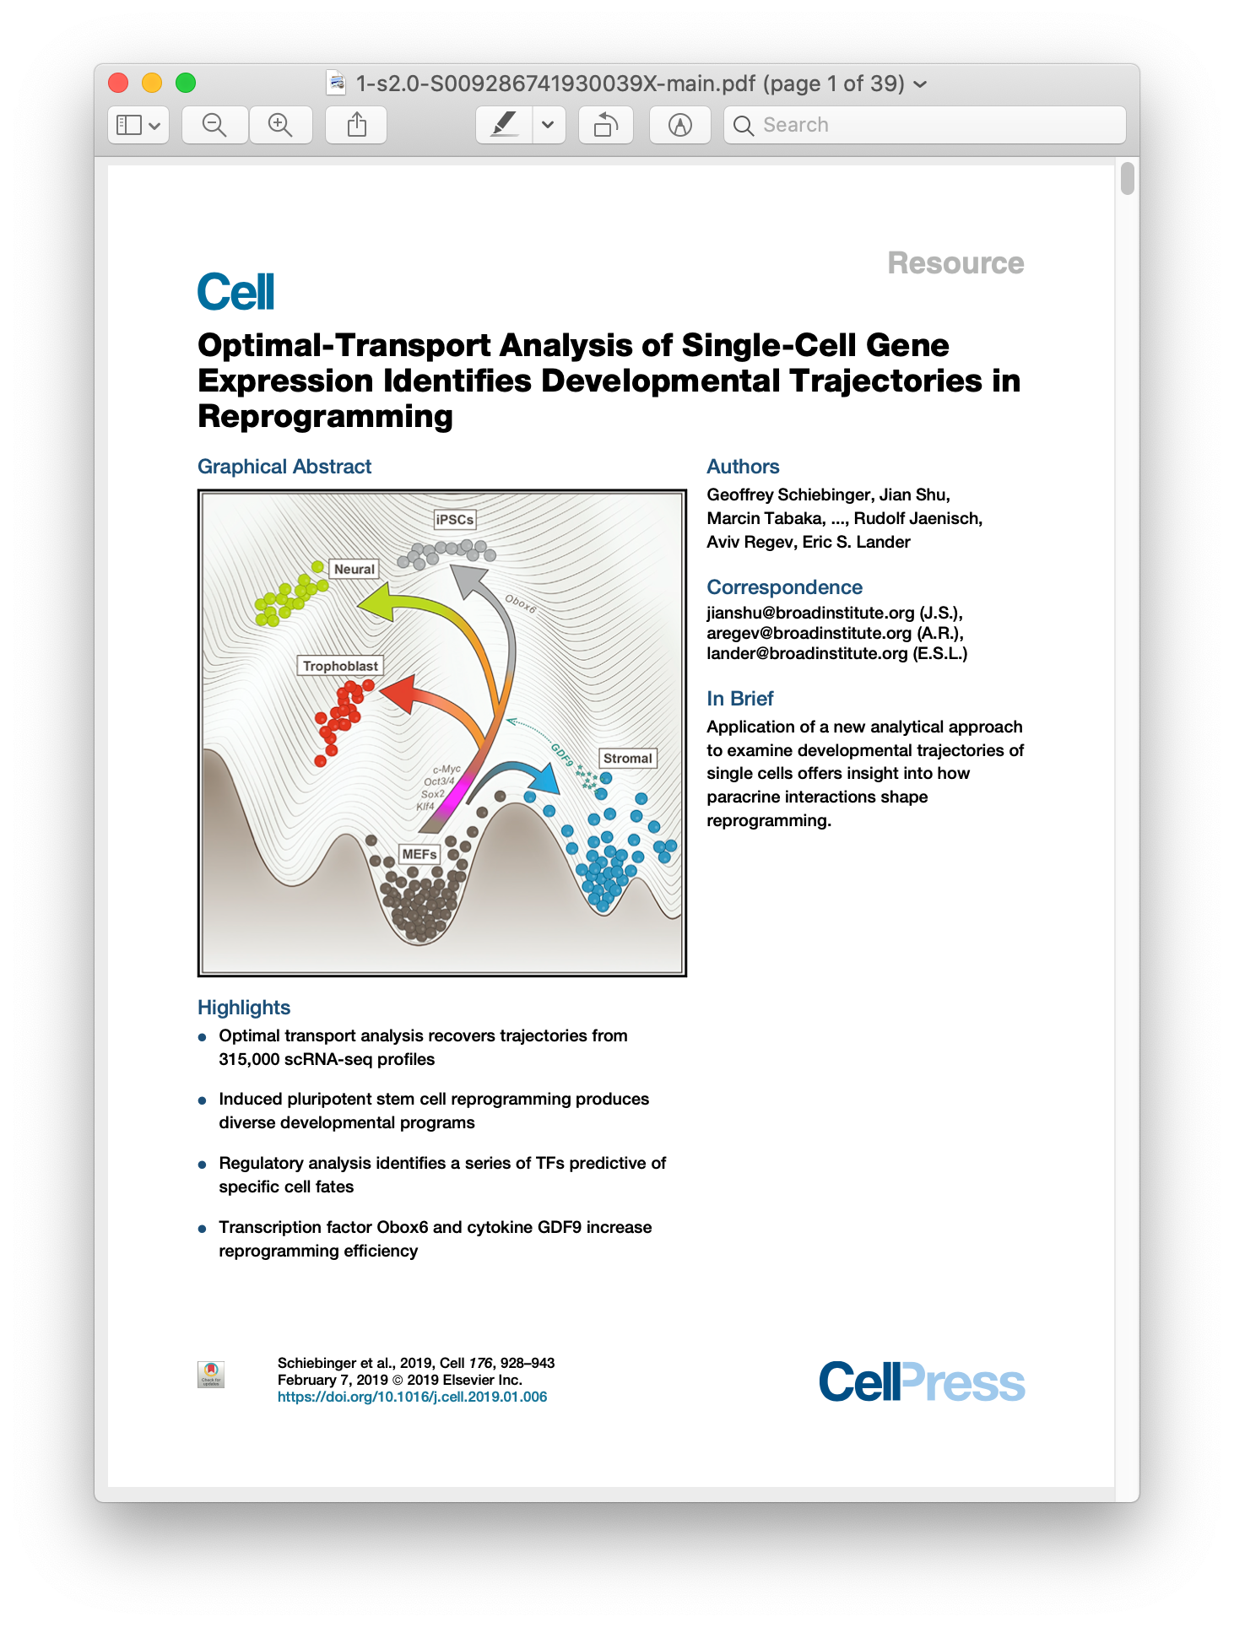
Leveraging time series to reconstruct developmental transitions
Fisher et al. (2019)
Schiebinger et al. (2019)

Slide 12
Leveraging time series to reconstruct gene-gene relationships
Qiu et al. Cell Systems (2020)
https://doi.org/10.1016/j.cels.2020.02.003

Slide 13
Introduction to Deep Learning
Notes:
TA introduction
Talk about not teaching code (not a programming workshop)

Slide 14
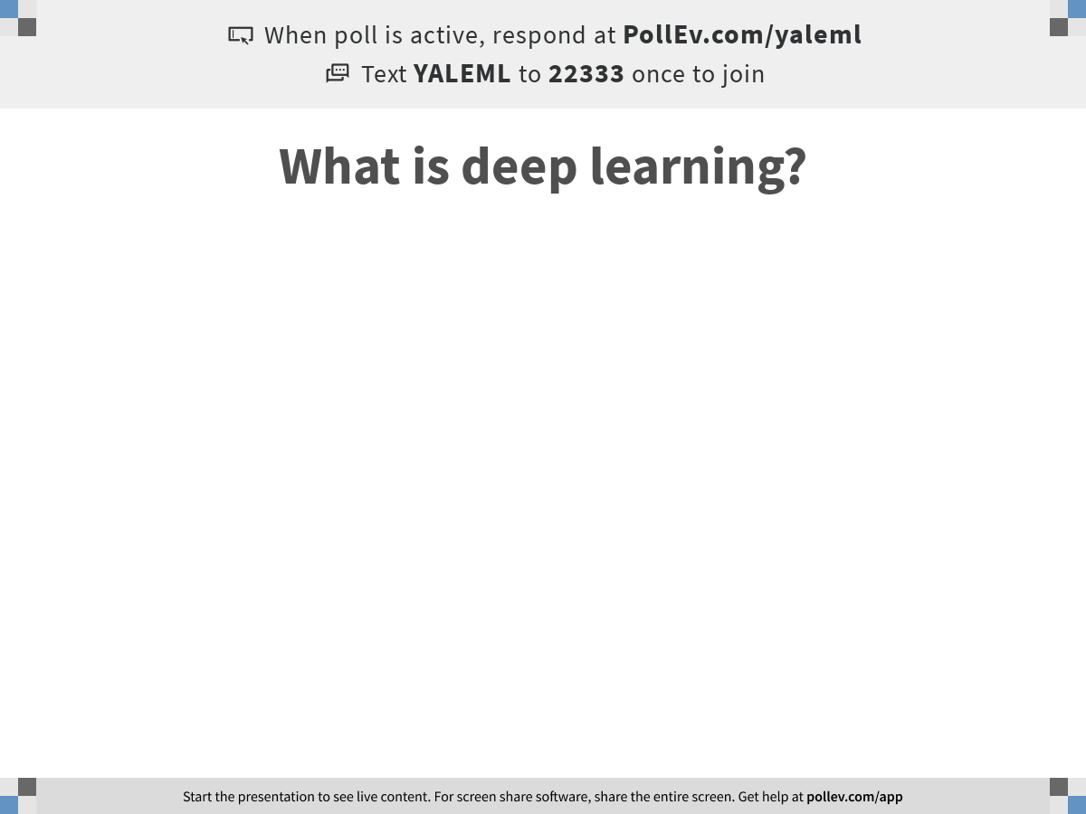
Notes:
What is deep learning?
https://www.polleverywhere.com/free_text_polls/n6Cd9E8zhpiOXcrSWg7aN

Slide 15
2-parameter function
Can learn any line

Slide 16
K parameter function
Parameters add power!
Any kth degree polynomial

Slide 17
More parameters
Allow you to approximate any function

Slide 18
Neural Networks
Highly parameterized networks, very flexible
Universal function approximators
https://medium.com/@LightOnIO/beyond-overfitting-and-beyond-silicon-the-double-descent-curve-18b6d9810e1b

Slide 19
Depth
Deep learning comes from the composition of many layers of multiparameter functions
Why is function composition useful?
Imagine image data, input variables are single pixels
First layer computes functions of pixels
Second layer can computes functions of groups of nearby pixels (edges, lines)
Later layers can recognize complex objects

Slide 20
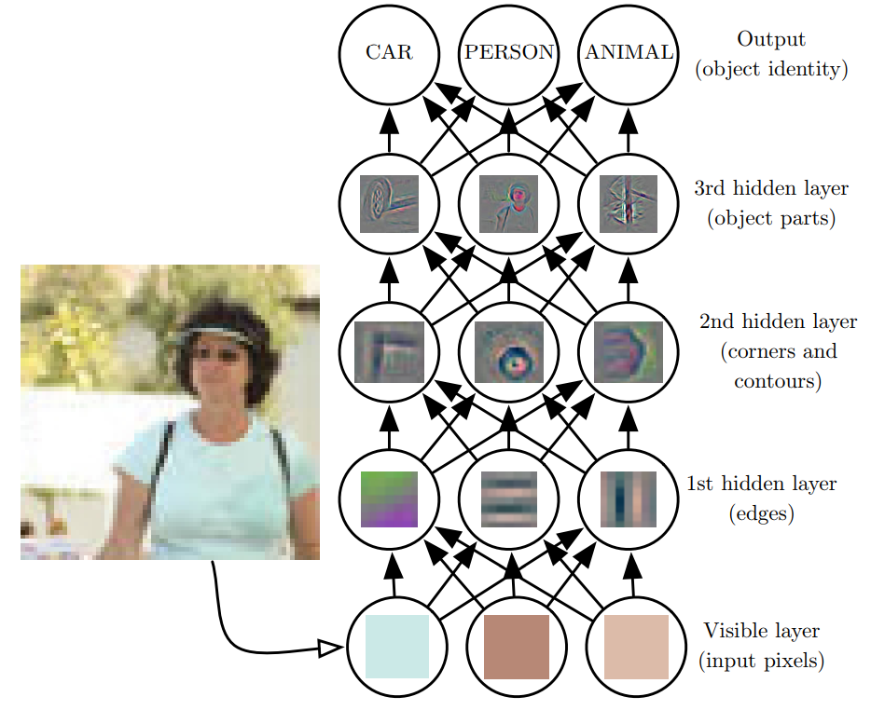
Why go deep?
Goodfellow et al., 2016
Notes:
Deep learning has the tendency to break the data down into different representations at different layers. Input is presented at the visible layer and the hidden layers extract increasingly abstract features which are then used, for example, to classify

Slide 21
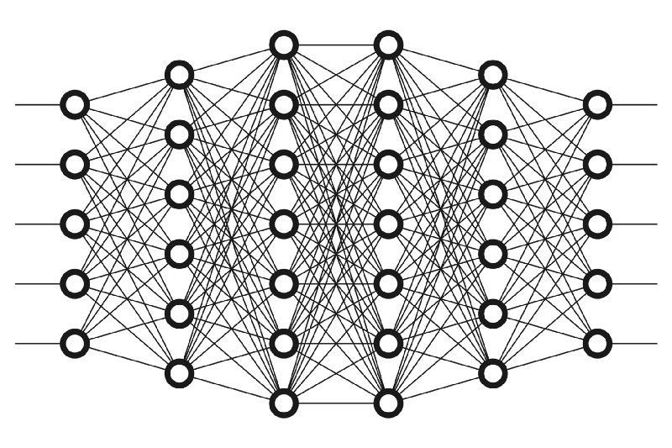
Neural Network Picture

Slide 22
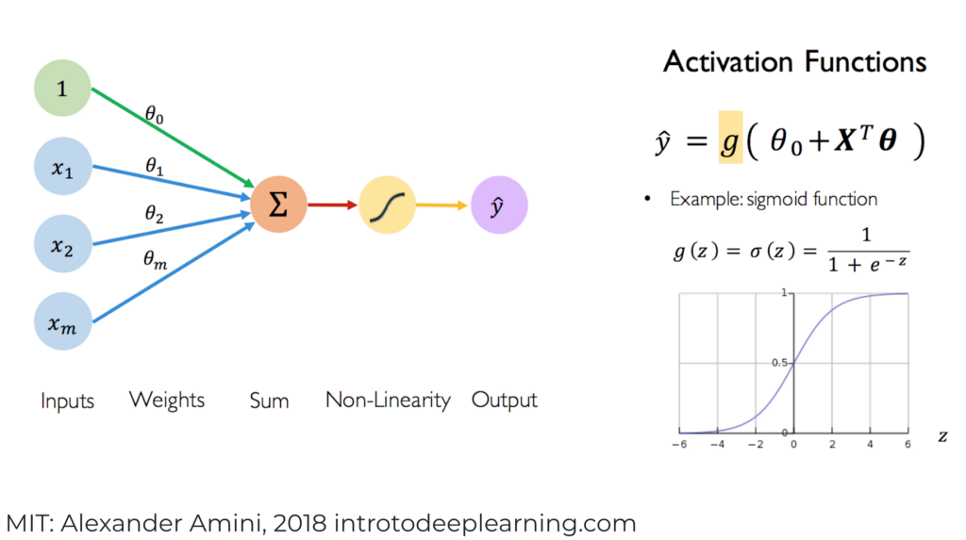
Cascades of Neurons

Slide 23
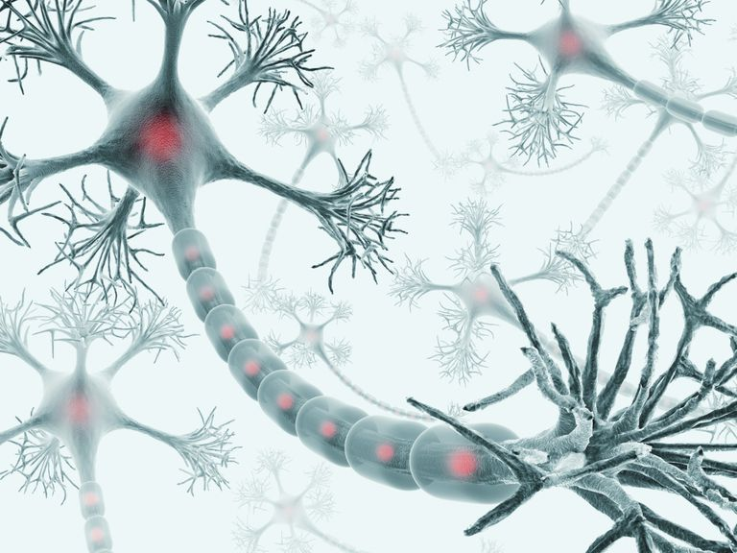
Inspired by Biological Neurons

Slide 24
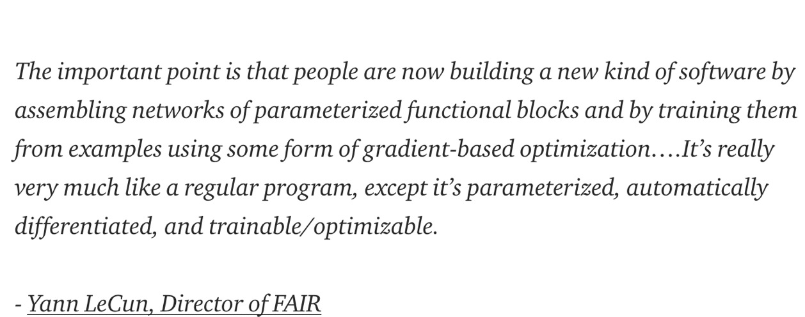
Differentiable Computing

Slide 25
Artificial Neural Networks
A computing system made up of simple, interconnected processing elements that process information by their dynamic state response to external inputs
Loosely inspired by neural computation, hence processing elements are called “neurons”
Trained with instead of programmed
Capacity to encode vast array of functions and learn makes them capable of learning complicated functions of inputs amenable to various tasks

Slide 26
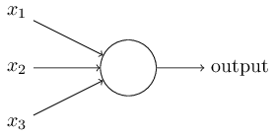
The perceptron
Developed in 1950’s and 1960’s by Frank Rosenblatt
Binary inputs
Single binary output
Example:
Nielsen, 2015
Notes:
In general could have more or fewer inputs.
Mention that figures come from Michael Nielsen’s book

Slide 27
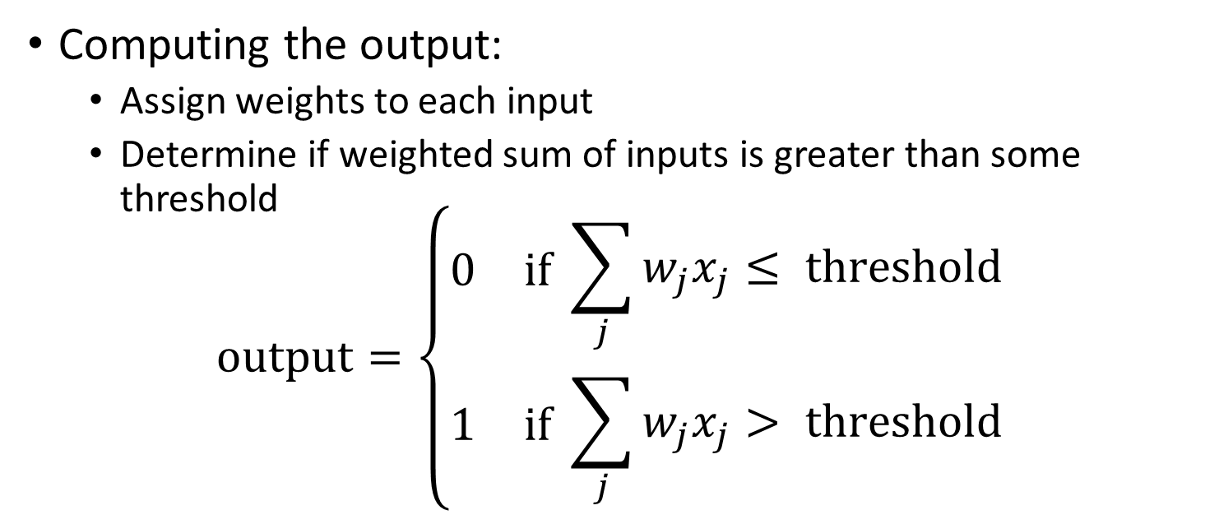
The perceptron
Nielsen, 2015
Computing the output:
Assign weights to each input
Determine if weighted sum of inputs is greater than some threshold
$$\text{output}=\left\{\begin{aligned}\begin{matrix}0 & \text{if} \end{matrix}\sum_{j}{w_{j}x_{j}}≤ \text{threshold} \\ \begin{matrix}1 & \text{if} \end{matrix}\sum_{j}{w_{j}x_{j}> \text{threshold}}\end{aligned}\right.$$

Slide 28
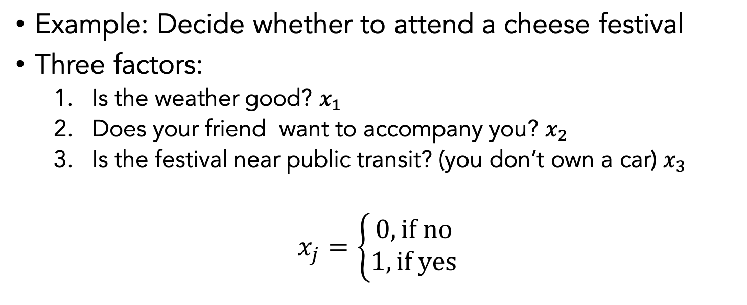
Nielsen, 2015
Example: Decide whether to attend a cheese festival
Three factors:
Is the weather good? $x_{1}$
Does your friend want to accompany you? $x_{2}$
Is the festival near public transit? (you don’t own a car) $x_{3}$
$$x_{j}=\left\{\begin{aligned}0, \text{if} \text{no} \\ 1, \text{if} \text{yes}\end{aligned}\right.$$

Slide 29
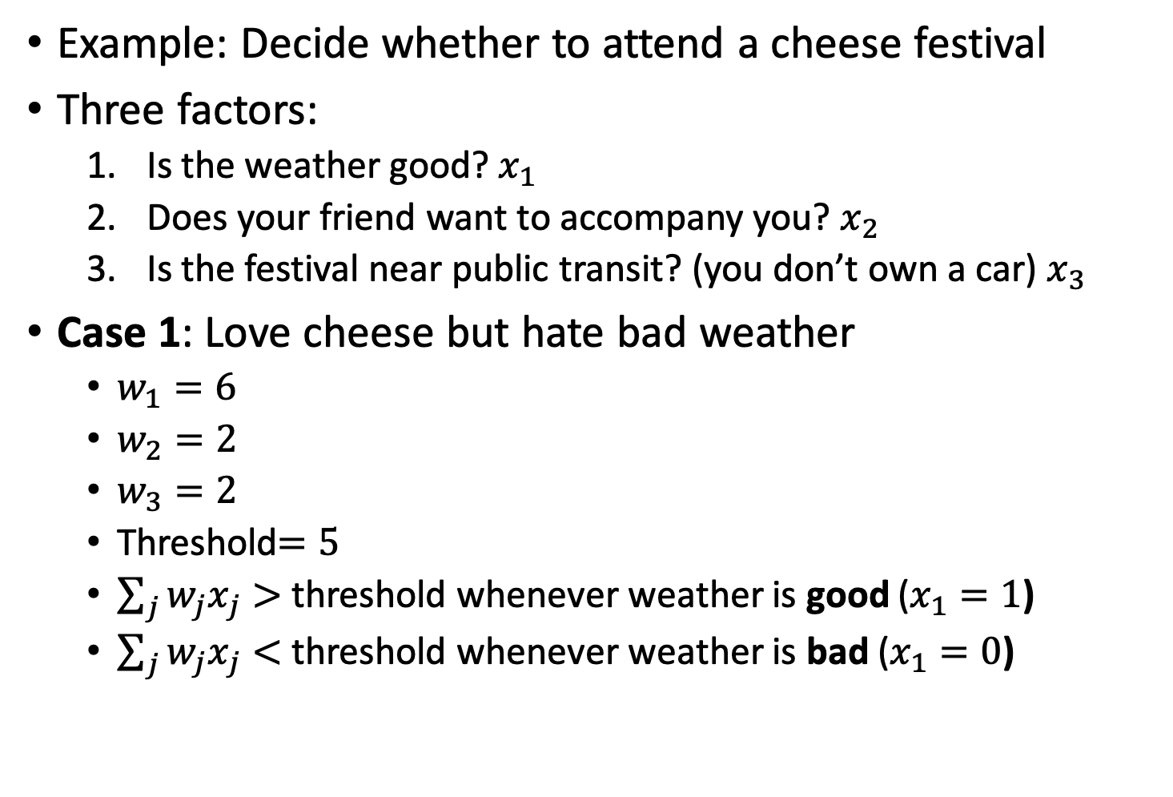
Example: Decide whether to attend a cheese festival
Three factors:
Is the weather good? $x_{1}$
Does your friend want to accompany you? $x_{2}$
Is the festival near public transit? (you don’t own a car) $x_{3}$
Case 1: Love cheese but hate bad weather
$w_{1}=6$
$w_{2}=2$
$w_{3}=2$
Threshold$=5$
$\sum_{j}{w_{j}x_{j}}>$ threshold whenever weather is good ($x_{1}=1$)
$\sum_{j}{w_{j}x_{j}}<$ threshold whenever weather is bad ($x_{1}=0$)
Notes:
The large value for w_1 indicates that the weather matters a lot more than whether bf or gf attend or nearness of public transit

Slide 30
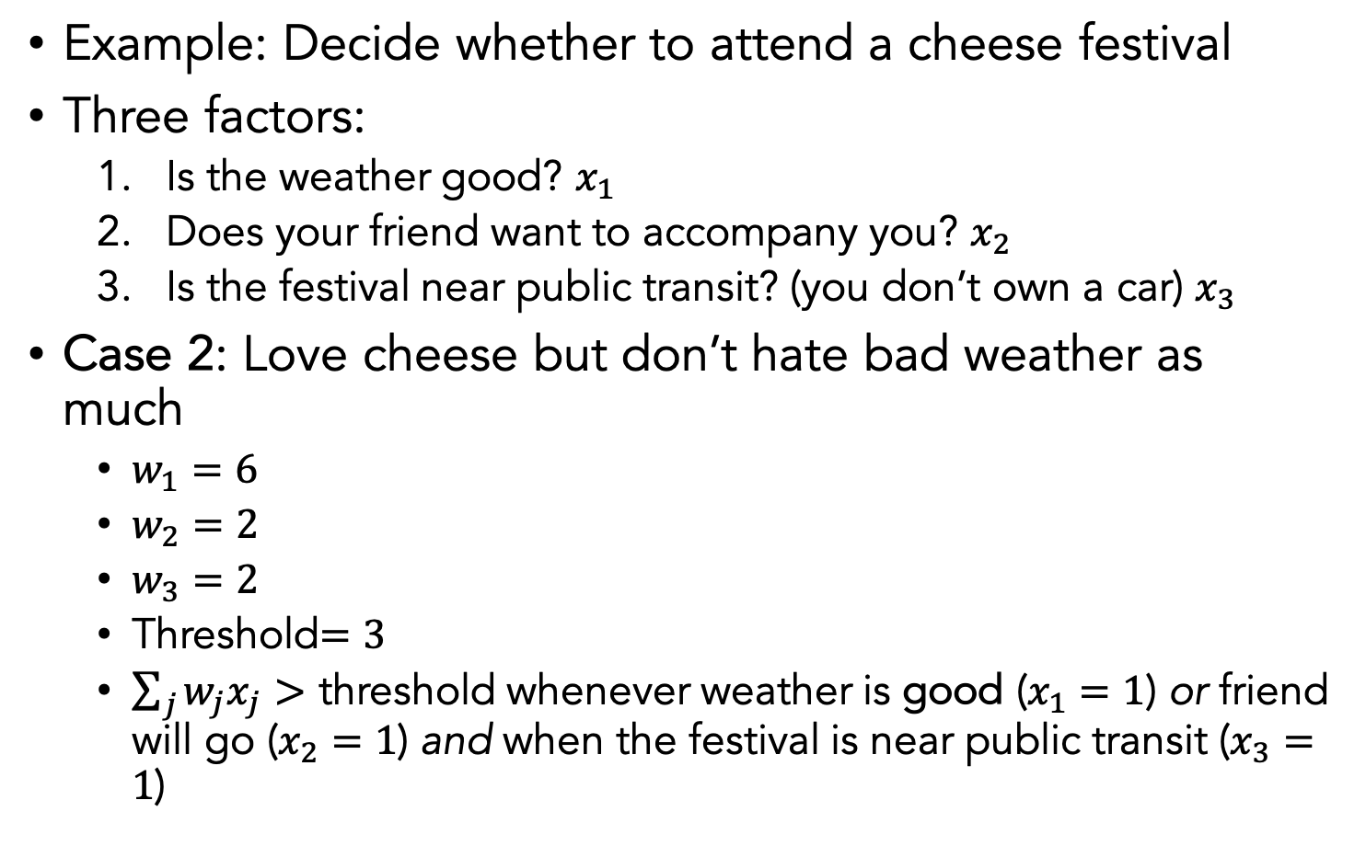
Example: Decide whether to attend a cheese festival
Three factors:
Is the weather good? $x_{1}$
Does your friend want to accompany you? $x_{2}$
Is the festival near public transit? (you don’t own a car) $x_{3}$
Case 2: Love cheese but don’t hate bad weather as much
$w_{1}=6$
$w_{2}=2$
$w_{3}=2$
Threshold$=3$
$\sum_{j}{w_{j}x_{j}}>$ threshold whenever weather is good ($x_{1}=1$) or friend will go ($x_{2}=1$) and when the festival is near public transit ($x_{3}=1$)
Notes:
Dropping the threshold means you’re more willing to go to the festival

Slide 31
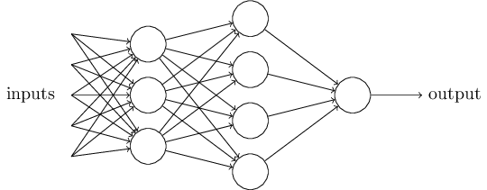
The multilayer perceptron (MLP)
A single perceptron is pretty simple
A complex network of perceptrons can make subtle decisions
First Layer
Second Layer
Nielsen, 2015
Notes:
In this network, the first column of perceptrons - what we'll call the first layer of perceptrons - is making three very simple decisions, by weighing the input evidence. What about the perceptrons in the second layer? Each of those perceptrons is making a decision by weighing up the results from the first layer of decision-making. In this way a perceptron in the second layer can make a decision at a more complex and more abstract level than perceptrons in the first layer. And even more complex decisions can be made by the perceptron in the third layer. In this way, a many-layer network of perceptrons can engage in sophisticated decision making.
Emphasize that it is the same output going to each node

Slide 32
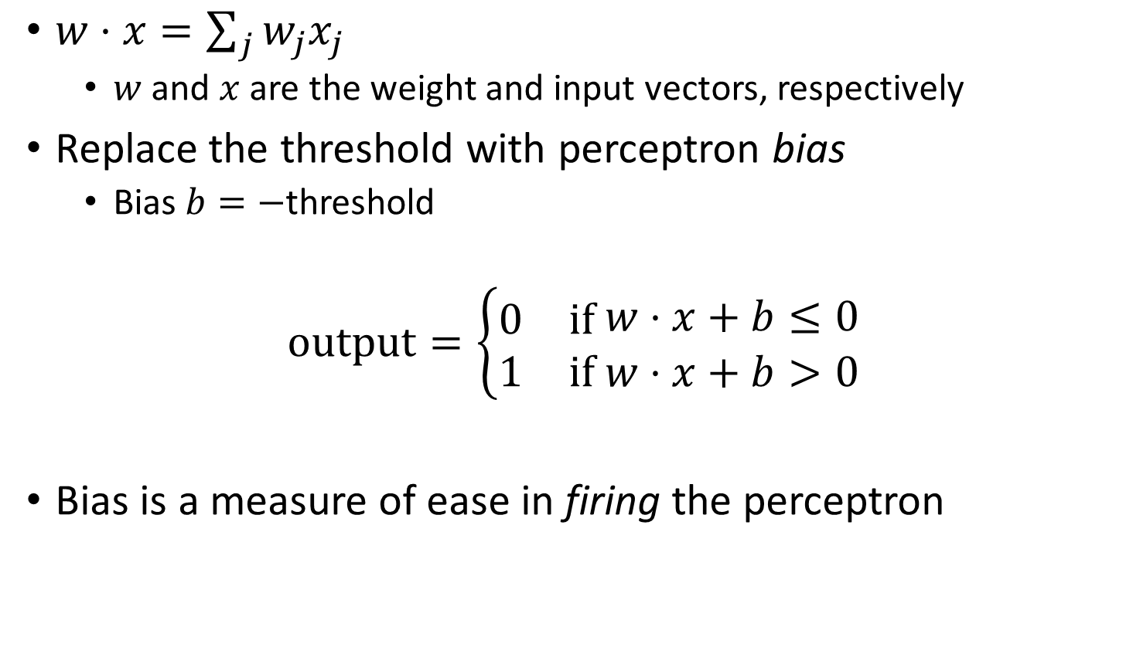
Bias
$w⋅x=\sum_{j}{w_{j}x_{j}}$
$w$ and $x$ are the weight and input vectors, respectively
Replace the threshold with perceptron bias
Bias $b=−$threshold
$$\text{output}=\left\{\begin{aligned}\begin{matrix}0 & \text{if} \end{matrix}w⋅x+b≤0 \\ \begin{matrix}1 & \text{if} w⋅x+b>0\end{matrix}\end{aligned}\right.$$
Bias is a measure of ease in firing the perceptron

Slide 33
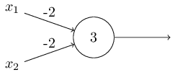
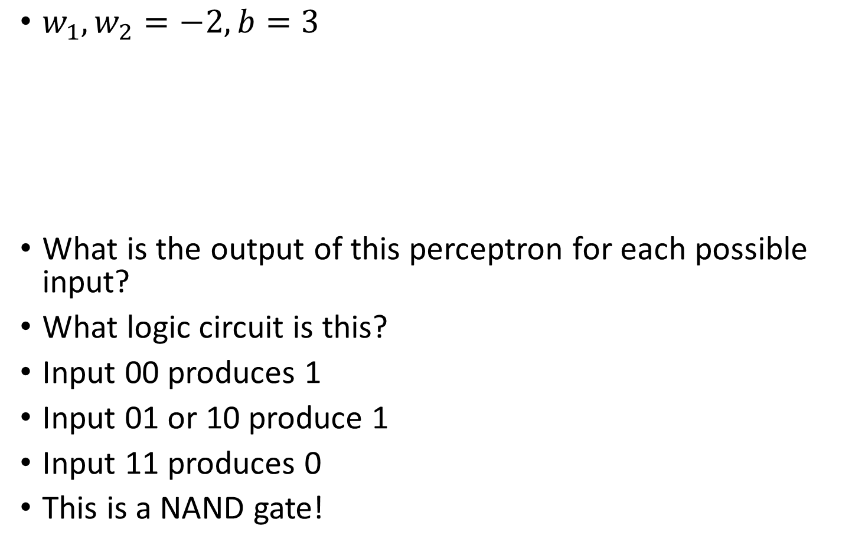
Logic circuits with perceptrons
$w_{1},w_{2}=−2, b=3$
What is the output of this perceptron for each possible input?
What logic circuit is this?
Input 00 produces 1
Input 01 or 10 produce 1
Input 11 produces 0
This is a NAND gate!
Nielsen, 2015
Notes:
Write this on the board maybe

Slide 34
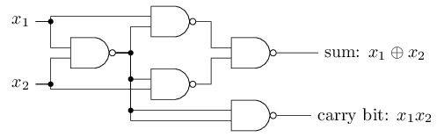
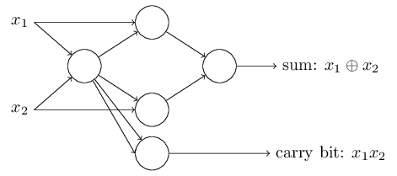
Logic circuits with perceptrons
NAND gates are universal for computation
Any computation can be built from NAND gates
Therefore, perceptrons are universal for computation
Bitwise addition:
Nielsen, 2015

Slide 35
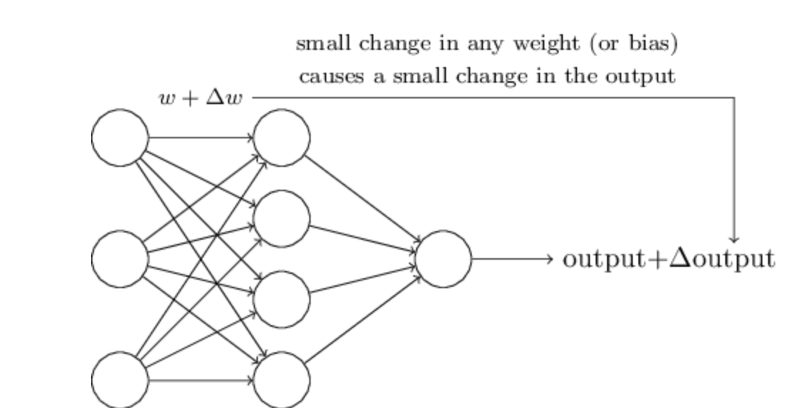
Problem with Logical Functions
Hard to “tune” in a traditional sense
Small change in weight can lead to large changes in conditions (or on change at all)
Think the volume knob in your car behaving this way
For this to happen we need neurons to perform a continuous differentiable function

Slide 36
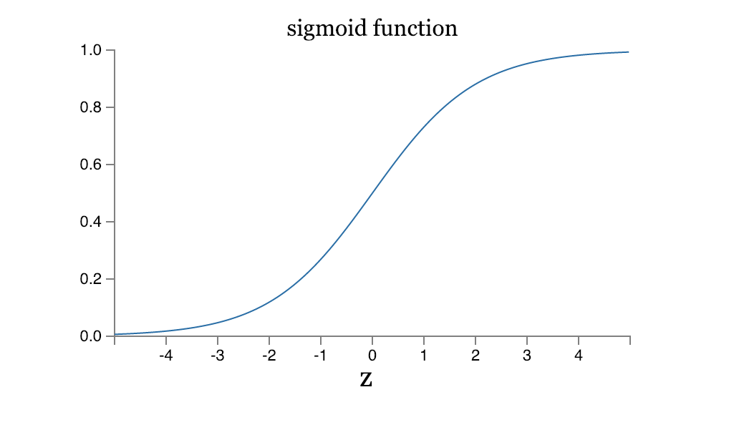
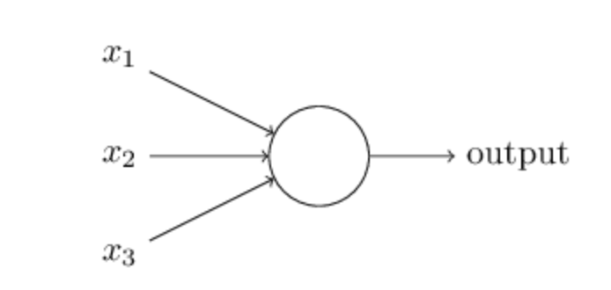
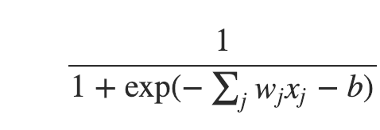
Sigmoidal Neuron

Slide 37
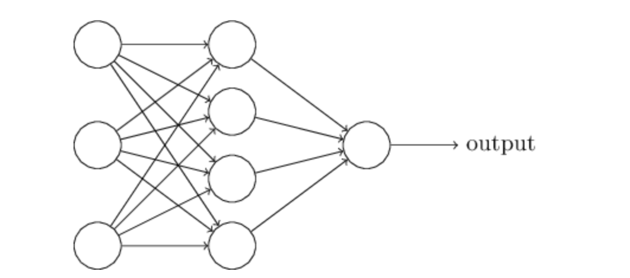
Multi-layers of Neurons

Slide 38
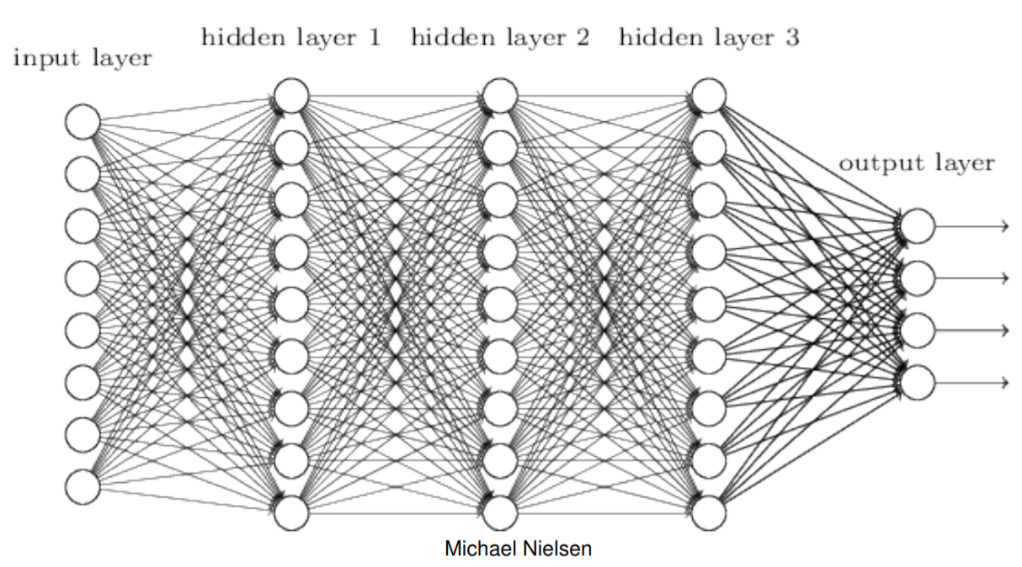
Differentiable Computing
We can create learning algorithms that automatically tune the weights and biases with Gradient Descent
Tuning occurs in response to external stimuli and w/o direct intervention
Creates a circuit designed for the problem at hand
Notes:
We already know how to make NAND gates, so this is hardly big

Slide 39
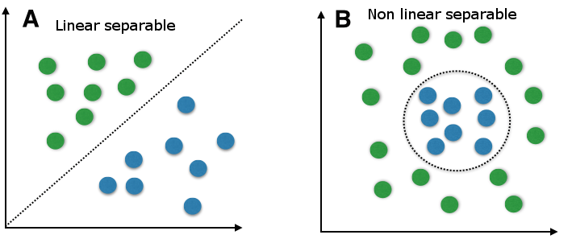
Why go deep?
Depth = complexity
Single layer perceptrons can only handle linear separability
Notes:
A major reason is that how the data is represented is important. On the left, if you were tasked with using a straight line to separate the two types of data, you would fail. On the right though, by simply transforming the data into a different coordinate system, it becomes very easy to do.

Slide 40
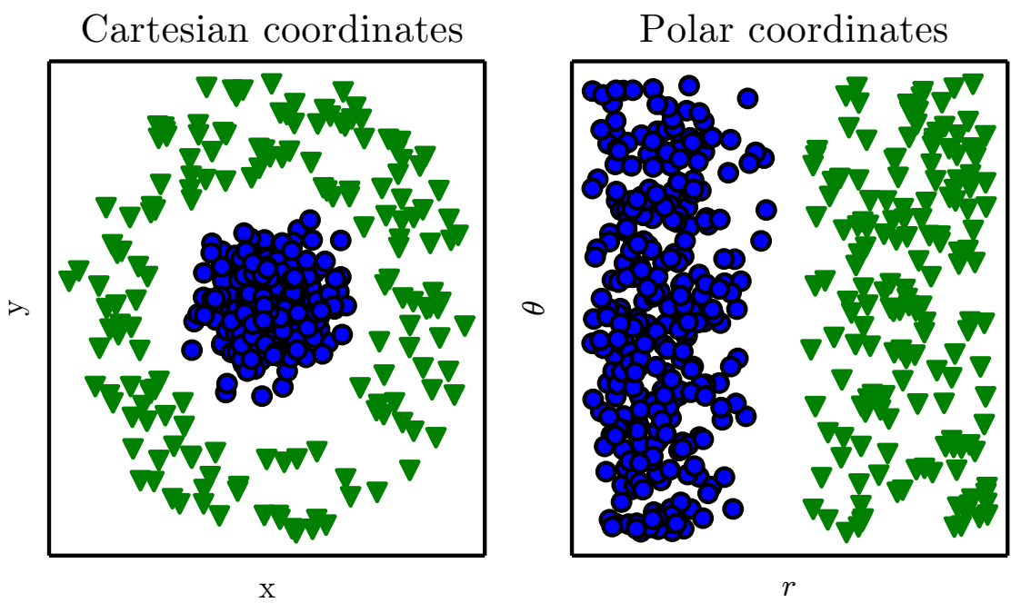
Representations matter
Goodfellow et al., 2016
Notes:
A major reason is that how the data is represented is important. On the left, if you were tasked with using a straight line to separate the two types of data, you would fail. On the right though, by simply transforming the data into a different coordinate system, it becomes very easy to do.

Slide 41
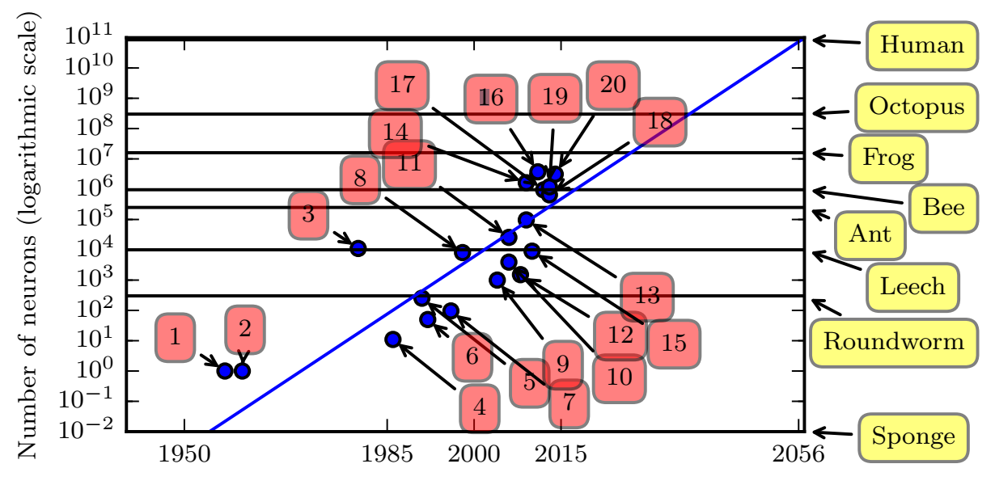
Increasing # of neurons
Goodfellow et al., 2016
1. Perceptron (Rosenblatt, 1958)
4. Early backpropagation network
6. MLP for speech recognition (Bengio et al, 1991)
11. GPU-accelerated convolutional network (Challeapilla et al., 2006)
20. GoogLeNet (Szegedy et al., 2014a)
Notes:
Neural network size is increasing over time. Note that we’re still below the level of a frog.

Slide 42
Design choices for an ANN
Learning algorithms
Backpropagation
Stochastic gradient descent (SGD)
Activation function (e.g. threshold)
Cost functions
Number and dimension of layers
Connections between layers
Regularizations
Layers
Batches
More…
Notes:
You can imagine that we can solve a rich set of problems by various design choices. Emphasize that we can have nonlinear functions and also continuous inputs and outputs instead of binary. We will cover all of these in detail throughout the course and is a large focus of the beginning

Slide 43
Fully connected network
Every feature interacts with every other feature
Weight matrix at every level allowed to be dense

Slide 44
Training Neural Networks

Slide 45
Review: Supervised Machine Learning
Learning where there are training data with labels
Two major types of supervised learning tasks
Regression tasks
Classification tasks
Classification tasks have discrete labels
Ex: Digit type classification
Regression tasks have continuous labels
Ex: Linear regression

Slide 46
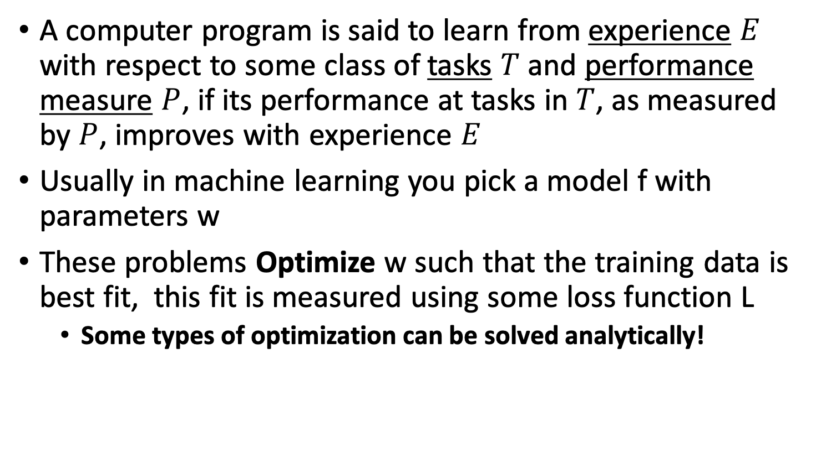
Model Parameter Optimization
A computer program is said to learn from experience $E$ with respect to some class of tasks $T$ and performance measure $P$, if its performance at tasks in $T$, as measured by $P$, improves with experience $E$
Usually in machine learning you pick a model f with parameters w
These problems Optimize w such that the training data is best fit, this fit is measured using some loss function L
Some types of optimization can be solved analytically!

Slide 47
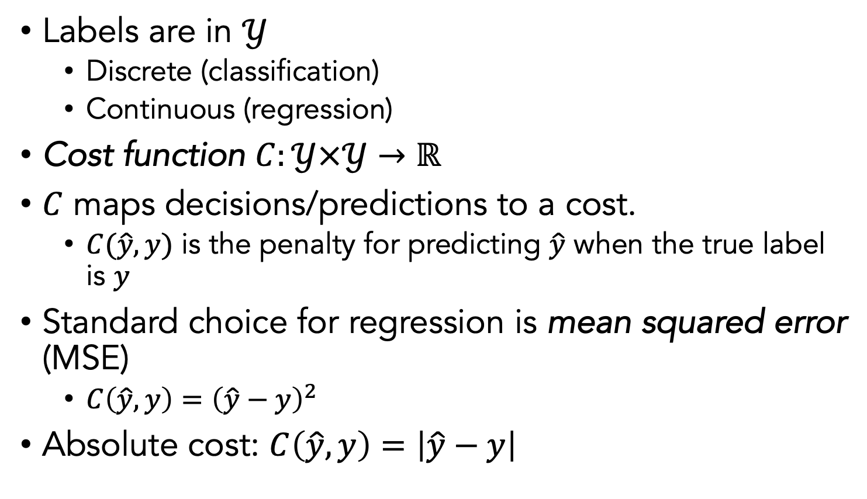
Cost functions
Labels are in $𝒴$
Discrete (classification)
Continuous (regression)
Cost function $C:𝒴×𝒴→ℝ$
$C$ maps decisions/predictions to a cost.
$C(\hat{y},y)$ is the penalty for predicting $\hat{y}$ when the true label is $y$
Standard choice for regression is mean squared error (MSE)
$C\left(\hat{y},y\right)={\left(\hat{y}−y\right)}^{2}$
Absolute cost: $C\left(\hat{y},y\right)=\left|\hat{y}−y\right|$

Slide 48
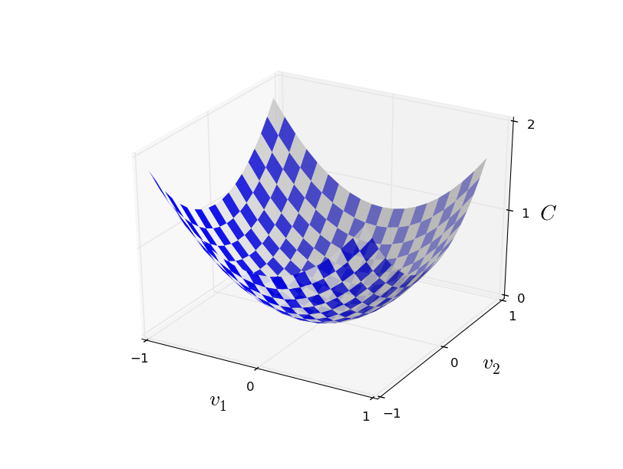
Cost/Loss Minimization
Minimum
Convex cost functions can be solved by differentiation, at the point where cost is minimum
the derivative wrt to parameters should be 0!

Slide 49
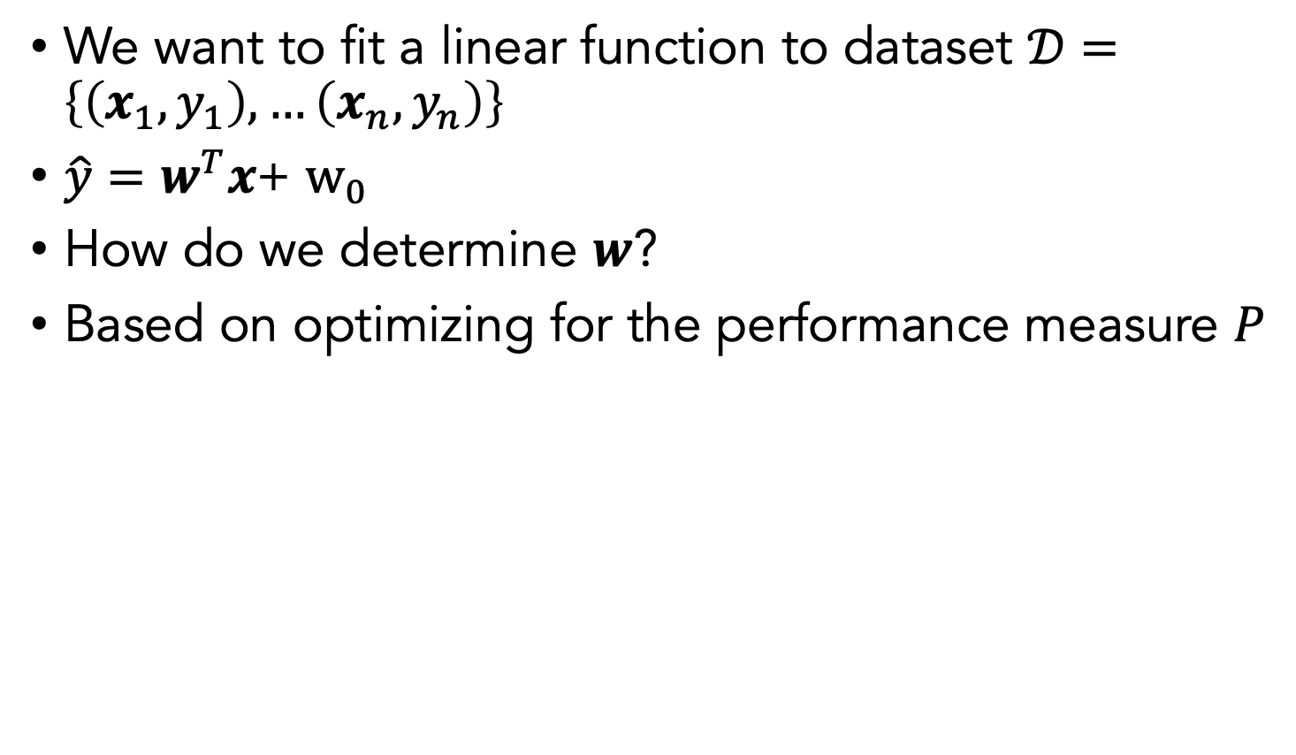
Ex: Linear Regression
We want to fit a linear function to dataset $𝒟=\left\{\left(x_{1},y_{1}\right),…\left(x_{n},y_{n}\right)\right\}$
$\hat{y}=w^{T}x$+ $w_{0}$
How do we determine $w$?
Based on optimizing for the performance measure $P$

Slide 50
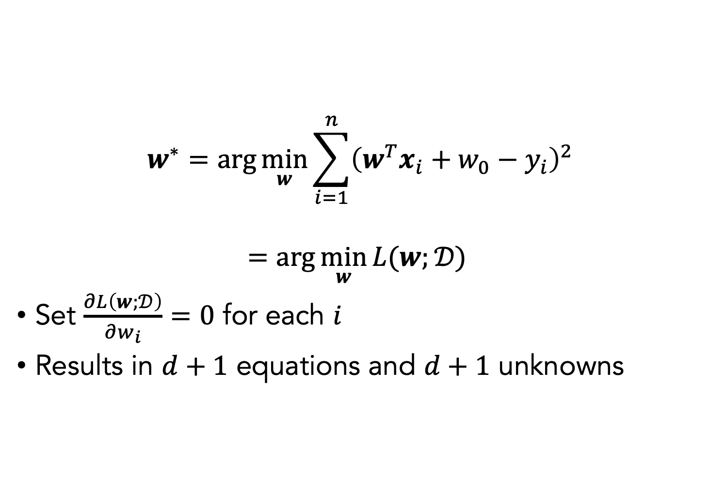
Linear Regression Optimization
$$w^{∗}=\arg{\min_{w}{\sum_{i=1}^{n}{{\left(w^{T}x_{i}+w_{0}−y_{i}\right)}^{2}}}}$$
$$=\arg{\min_{w}{L(w;}𝒟) }$$
Set $\frac{∂L\left(w;𝒟\right)}{∂w_{i}}=0$ for each $i$
Results in $d+1$ equations and $d+1$ unknowns

Slide 51
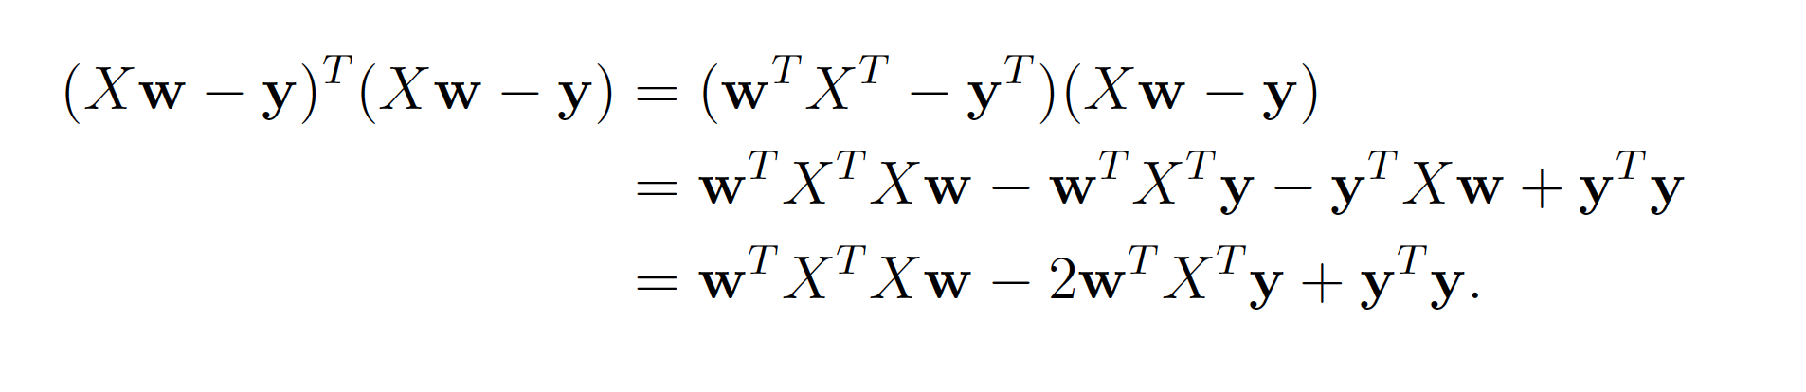
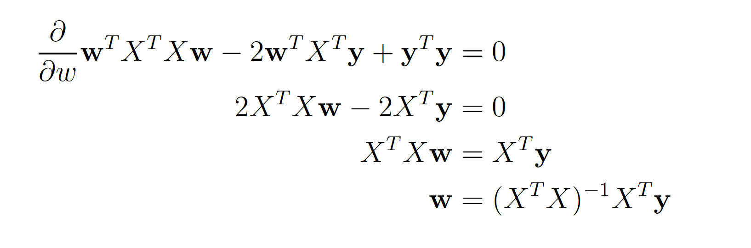

Mean squared error cost
$$w^{∗}=\arg{\min_{w}{\sum_{i=1}^{n}{{\left(w^{T}x_{i}+w_{0}−y_{i}\right)}^{2}}}}$$
Rewrite:

Slide 52
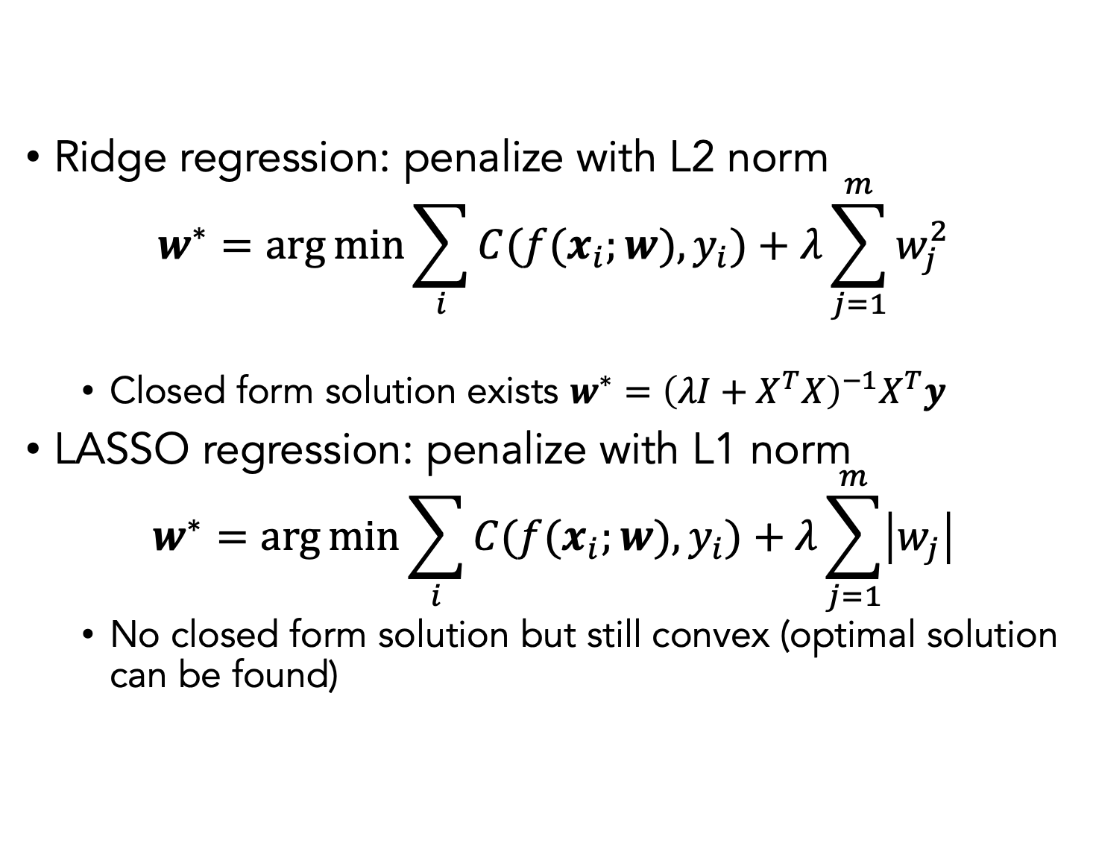
Regularization
Ridge regression: penalize with L2 norm
$$w^{∗}=\arg{\min{\sum_{i}{C(f(x_{i};w),y_{i})}+λ\sum_{j=1}^{m}{w_{j}^{2}}}}$$
Closed form solution exists $w^{∗}={\left(λI+X^{T}X\right)}^{−1}X^{T}y$
LASSO regression: penalize with L1 norm
$$w^{∗}=\arg{\min{\sum_{i}{C(f(x_{i};w),y_{i})}+λ\sum_{j=1}^{m}{\left|w_{j}\right|}}}$$
No closed form solution but still convex (optimal solution can be found)

Slide 53
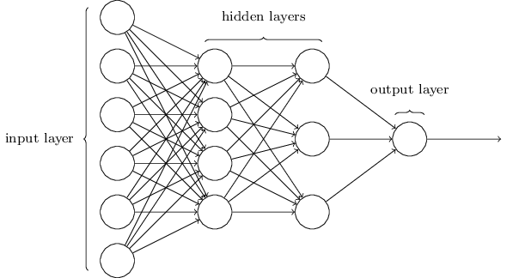
Classification/Regression Network
Sometimes called multi-layer perceptron (although sigmoid neurons are used)
Output from one layer is used as input for the next (feedforward network)
Notes:
Note that in recurrent neural networks, feedback is allowed
Note that the input layer and output layers are easily designed. Input is simply the entire size of the data input. The output will depend on the task. E.g., if we want to classify whether a digit is a 9 or not, then we have a single output neuron.
Designing the hidden layers is more difficult (and a reason why we have a whole course on this)

Slide 54
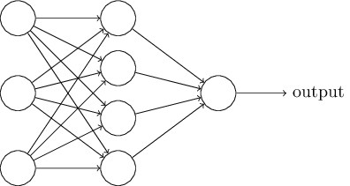
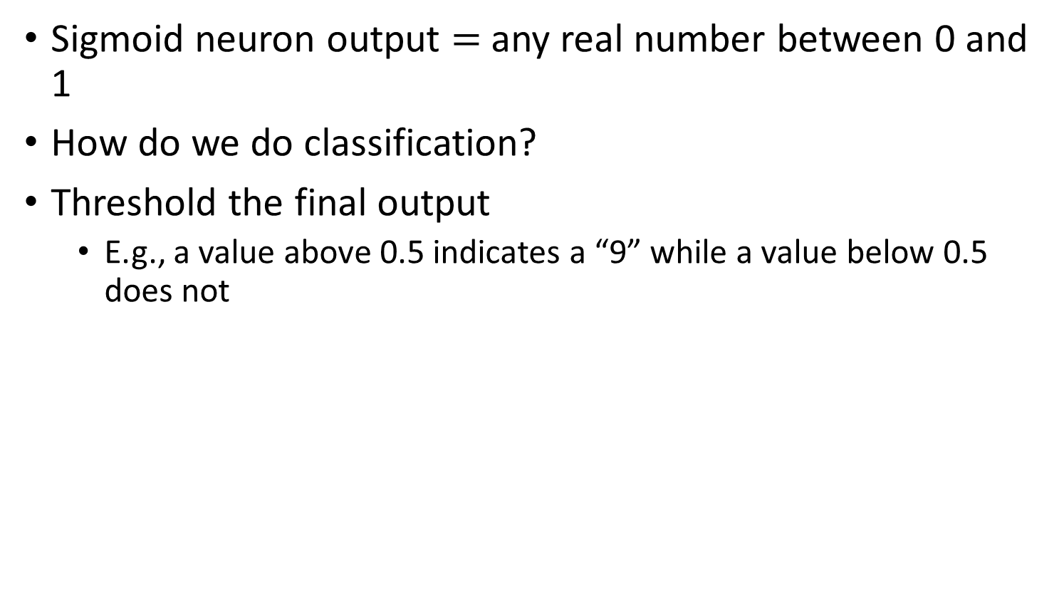
Classification with sigmoid neurons
Sigmoid neuron output $=$ any real number between 0 and 1
How do we do classification?
Threshold the final output
E.g., a value above 0.5 indicates a “9” while a value below 0.5 does not

Slide 55
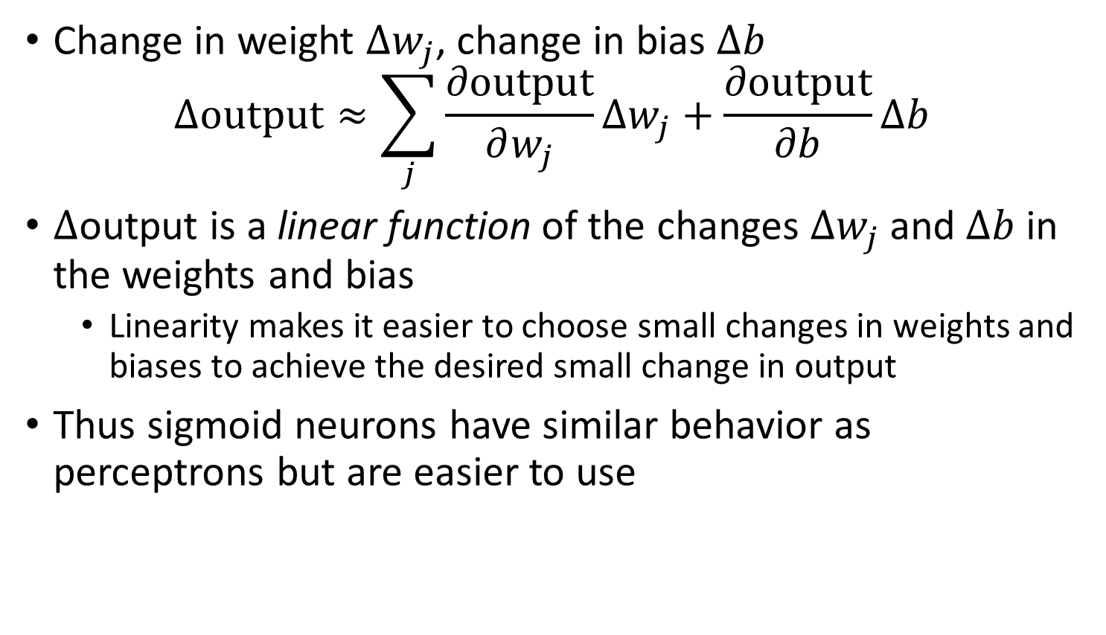
Weights, bias, and output
Change in weight $Δw_{j}$, change in bias $Δb$
$$Δ\text{output}≈\sum_{j}{\frac{∂\text{output}}{∂w_{j}}}Δw_{j}+\frac{∂\text{output}}{∂b}Δb$$
$Δ$output is a linear function of the changes $Δw_{j}$ and $Δb$ in the weights and bias
Linearity makes it easier to choose small changes in weights and biases to achieve the desired small change in output
Thus sigmoid neurons have similar behavior as perceptrons but are easier to use

Slide 56
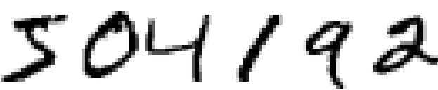
Handwritten digit recognition

Slide 57

Notes:
How would you write an algorithm for this?
https://www.polleverywhere.com/free_text_polls/1qj3UDGf5RFWsrvrLvYzF

Slide 58
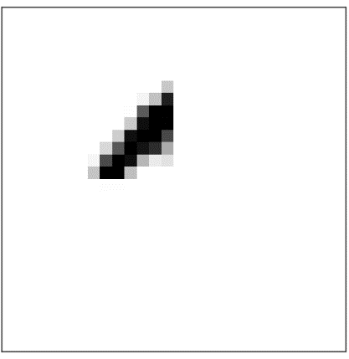
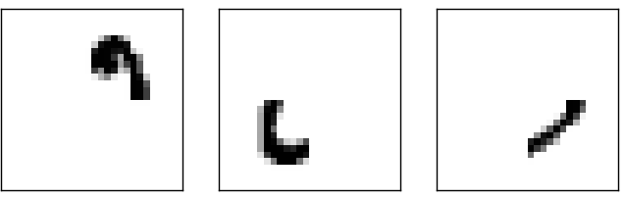


Number of output neurons
Possible heuristic:
$$=$$
Notes:
Suppose these parts result in the first four neurons of the hidden layer to be fired. The more neurons we have, the more likely these kinds of shapes will correspond to specific bits.
In contrast, if we only have four output neurons, then the first output neuron would try to decide what the most significant bit of the digit was, which isn’t easy to relate to the original image. However, it is possible that there is a 4 bit solution that works better. But generally, this parts-based representation heuristic seems to work well when designing neural networks

Slide 59

A simple network
Notes:
Describe the input (28 x 28 images, greyscale). Describe output (number the neurons 0 to 9, and choose the highest value as the classification)

Slide 60

Forward Propagation
Store weights and biases as matrices
Suppose we are considering the weights from the second (hidden) layer to the third (output) layer
$w$ is the weight matrix with $w_{jk}$ the weight for the connection between the $k$th neuron in the second layer and the $j$th neuron in the third layer
$b$ is the vector of biases in the third layer
$a$ is the vector of activations (output) of the 2nd layer
$a^{′}$ the vector of activations (output) of the third layer
$$a^{′}=σ\left(wa+b\right)$$
Notes:
Note that we are applying the sigma function elementwise to every entry in the vector wa+b

Slide 61
How training works
In each epoch, randomly shuffle the training data
Partition the shuffled training data into mini-batches
For each mini-batch, apply a single step of gradient descent
Gradients are calculated via backpropagation (the next topic)
Train for multiple epochs

Slide 62
Gradient Descent & Backprop
Gradient descent refers to taking a step in the direction of the gradient (partial derivative) of a weight or bias with respect to the cost function
Gradients are propagated backwards through the network in a process known as backpropagation
The size of the step taken in the direction of the gradient is called the learning rate

Slide 63


First attempt
30 nodes in hidden layer
30 epochs
Mini-batch size $=10$
Learning rate $η=3.0$
Best accuracy at epoch 28: 95.42%
Notes:
95.42% accuracy with a relatively simple network.

Slide 64

Second attempt
100 nodes in hidden layer
30 epochs
Mini-batch size $=10$
Learning rate $η=3.0$
Improves accuracy to 96.59%
Although depends on initialization: some runs give worse results

Slide 65


Third attempt
100 nodes in hidden layer
30 epochs
Mini-batch size $=10$
Learning rate $η=0.001$

Slide 66


Debugging a neural network
What do we do if the output is essentially noise?
Suppose we ran the following as our first attempt:
30 nodes in hidden layer
30 epochs
Mini-batch size $=10$
Learning rate $η=100.0$
Notes:
What do we change?

Slide 67
Debugging a neural network
What can we do?
Should we change the learning rate?
Should we initialize differently?
Do we need more training data?
Should we change the architecture?
Should we run for more epochs?
Are the features relevant for the problem (i.e. is the Bayes error rate reasonable)?
Debugging is an art
We’ll develop good heuristics for choosing good architectures and hyper parameters

Slide 68

How well does our network do?
Need to compare to some baselines
Random guessing: 10% accuracy
Our network does much better
Simple idea: How dark is the image?
E.g. a 2 will typically be darker than a 1

Slide 69
Average darkness
Compute average darkness for each digit from the training data
Classify an image based on the digit with the closest average darkness
This gives 22.25% accuracy
Better than random guessing

Slide 70

Support Vector Machine (SVM)
Using default settings in SVM scikit-learn (a Python library) gives 94.35% accuracy
It’s possible to optimize tuning parameters to achieve 98.5% accuracy
Can neural networks do better?
Yes!
Record set in 2013 was 99.79% accuracy (only 21 wrong in the test data)
Can you do better?

Slide 71
Innards of Neural Networks

Slide 72
Gradient descent
How do we minimize a cost function in general?
Suppose we want to minimize some function $C\left(v\right)$
$v=v_{1},v_{2},…$
Minimum
Notes:
Goal is to find the minimum of the cost function. In this case, if we only have two variables, then it’s pretty easy to eyeball it.

Slide 73
Gradient descent
What if we have more variables?
Could try calculus to find extremum of $C$
Difficult when we have lots of variables
Largest neural networks have billions of weights and biases

Slide 74
Rolling ball analogy
Choose a random start point
Ball rolls to the bottom of the valley
Can simulate this by computing 1st and 2nd derivatives of $C$
Notes:
These derivatives tell us about the shape of the valley and how the ball should roll

Slide 75
The gradient
Choose a random starting point
Move small amounts $Δv_{1}$ in the $v_{1}$ direction and $Δv_{2}$ in the $v_{2}$ direction
$$ΔC≈\frac{∂C}{∂v_{1}}Δv_{1}+\frac{∂C}{∂v_{2}}Δv_{2}$$
Goal is to minimize $C$
Choose $Δv_{1}$ and $Δv_{2}$ so that $ΔC$ is negative
I.e. move in a direction that decreases $C$
Define $Δv={\left(Δv_{1},Δv_{2}\right)}^{T}$
The gradient of $C$ is $∇C={\left(\frac{∂C}{∂v_{1}},\frac{∂C}{∂v_{2}}\right)}^{T}$
$ΔC≈∇C⋅Δv$
Notes:
Pause here for a minute

Slide 76

The gradient
Define $Δv={\left(Δv_{1},Δv_{2}\right)}^{T}$
The gradient of $C$ is $∇C={\left(\frac{∂C}{∂v_{1}},\frac{∂C}{∂v_{2}}\right)}^{T}$
$ΔC≈∇C⋅Δv$
How should we choose $Δv$ to ensure $ΔC$ is negative?
Choose $Δv=−η∇C$
$η$ is a small, positive parameter (known as the learning rate)
$⇒ΔC≈−η∇C⋅∇C=−η{\left\|∇C\right\|}^{2}$
Since ${\left\|∇C\right\|}^{2}≥0$, $ΔC≤0$
Thus $C$ will always decrease and never increase
Thus, choose new position $v→v−η∇C$
Repeat until we reach the minimum

Slide 77

Summary of gradient descent
Compute the gradient $∇C$
Move in the opposite direction
It’s like falling down the slope of the valley

Slide 78
Gradient of a sigmoidal neuron
$f\left(z\right)=\frac{1}{1+e^{−z}}$
Use chain rule with g(z) = $e^{−z}$
$\frac{δ(f\left(g(z)\right) )}{δ(z)}$=$\frac{δ(f\left(g(z)\right) )}{δ(g(z))}\frac{δ(g(z) )}{δ(z)}$
$\frac{δ(f\left(g(z)\right) )}{δ(z)}$=$\frac{e^{−z}}{{(1+e^{−z})}^{2}}$
$\frac{δ(f\left(g(z)\right) )}{δ(z)}$=$\frac{1+e^{−z}−1}{{(1+e^{−z})}^{2}}$
$\frac{δ(f\left(g(z)\right) )}{δ(z)}$=$\frac{(1+e^{−z})}{{(1+e^{−z})}^{2}}$- $\frac{1}{{(1+e^{−z})}^{2}}$
$\frac{δ(f\left(g(z)\right) )}{δ(z)}$= $\frac{1}{1+e^{−z}}$ - $\frac{1}{{(1+e^{−z})}^{2}}$
Nice form of answer is $\frac{δ(f\left(g(z)\right) )}{δ(z)}$=f(z) (1-f(z))
How do you get this in terms of weights and biases?

Slide 79
Backpropagation
Propagates gradient backward through the circuit, by using the chain rule of differentiation
f(g(x))=f’(g(x))g’(x)
So if output node is f(W_{o},Y) and we ”open out Y” into g(W₁,X) where X is the input of the previous layer then we have to chain the derivatives as f’(W_{o},g(W₁,X)) g’(W₁,X)
Remember these derivatives are wrt to the weights of the network!
Detailed derivations are in Nielsen book

Slide 80
Regularization

Slide 81
Regularization
In neural networks regularizations express a preference for simpler solutions
Yields an inductive bias in the solution space
Sometimes can get solution out of local minima
How do we define “simple” ?
Regularizations are not the same as in low-parameters where capacity is restricted

Slide 82

Weight decay/L2 regularization
Add a regularization term to the cost function:
$$C=−\frac{1}{n}\sum_{xj}{\left[y_{j}\ln{a_{j}^{L}}+\left(1−y_{j}\right)\ln\left(1−a_{j}^{L}\right)\right]}+\frac{λ}{2n}\sum_{w}{w^{2}}$$
First term is the cross-entropy cost function
Second term is the regularization term
Scaled by factor $\frac{λ}{2n}$, $λ$ the regularization parameter
Can write regularized cost function as
$$C=C_{0}+\frac{λ}{2n}\sum_{w}{w^{2}}$$
$C_{0}$ is the unregularized cost

Slide 83

Weight decay/L2 regularization
$$C=C_{0}+\frac{λ}{2n}\sum_{w}{w^{2}}$$
Regularization forces the weights to be small
Large weights allowed only if they considerably improve $C_{0}$
I.e., regularization is a compromise between finding small weights and minimizing the cost function $C_{0}$
$λ$ controls this compromise
Small $λ⇒$ we prefer to minimize $C_{0}$
Large $λ⇒$ we prefer small weights
How do we apply regularization in gradient descent?

Slide 84



L2 regularization applied to MNIST
30 hidden neurons
Train with first 1,000 training images
Cross-entropy cost
Learning rate $η=0.5$
Mini-batch size $10$
$λ=0.1$
Training cost decreases with each epoch
Test accuracy continues to increase
More epochs would likely improve results further
Regularization improves generalization in this case
Notes:
Accuracy is 87% compared to 82.27% in the unregularized case

Slide 85
Convolutions

Slide 86

Images are a series of Pixel Values
Grayscale images:
0=Black
255 = White
Spatial locality structure

Slide 87

Local receptive fields
Make connections in small, localized regions of the input image
Image taken from Michael Neilsen’s book “Neural Networks and Deep Learning”

Slide 88

Local receptive fields
Slide the local receptive field over by one (or more) pixel and repeat
Image taken from Michael Neilsen’s book “Neural Networks and Deep Learning”

Slide 89



The convolution operation
Filter/
Feature detector
Pointwise multiply
Add results
Translate filter
Image

Slide 90

Pooling
Downsampling the results by pooling values by averaging or max
Max pool is used more commonly

Slide 91

CNN Architecture
Each convolutional unit has the same weight.

Slide 92
Binding Motif Prediction

Slide 93
Autoencoders

Slide 94
Unsupervised learning
Dataset contains only features and no labels
Goal is to find hidden patterns in the unlabeled data
Examples
Density estimation
Data generation
Clustering
Data denoising
Representation learning
Semi-supervised learning attempts to combine information from both labeled and unlabeled data to deduce information
Notes:
What might this be useful for?

Slide 95
Representation learning
Find the “best” representation of the data
I.e., find a representation of the data that preserves as much information as possible while obeying some penalty or constraint that simplifies the representation
What information do we want to preserve?
How do we define simple?
Low-dimensional
Sparse
Independent components
Above criteria aren’t necessarily mutually exclusive
E.g., low-dimensional representations often have independent or weakly dependent components
Notes:
These criteria aren’t necessarily mutually exclusive

Slide 96
Representation learning
Why is a simple representation useful?
Interpretability
E.g. visualization
Computational cost
Compression
Performance
Preprocessing
Notes:
Mention that for computational cost, this can include memory and storage

Slide 97

Manifold assumption
Data may be modeled as lying on a low-dimensional manifold
Notes:
Can model the actual data as lying on a low dimensional manifold and there is some corrupting process that forces the data point off the manifold (point to the gray arrow; and then all the green arrows). From this assumption, we can often use powerful ways to learn some lower-dimensional representation of the data.

Slide 98

Example
What is a good lower dimensional representation of this data?
How can we find it?

Slide 99

Autoencoder
Informational Bottleneck
Reconstruction Error
[Hinton, Salakhutdinov, Science 2006]
Notes:
Here is an example of an autoencoder. The autoencoder tries to reconstruct its input, after passing it through the layers of the network.
Notice that there is an informational bottleneck here that we’ll talk about in a second.

Slide 100

Autoencoder (AE)
Neural network trained to copy its input $x$ to its output
Hidden layer $z$ describes a code to represent the input
Two parts
Encoder: $z=f(x)$
Decoder: $x^{′}=g(z)$
Goal: minimize C$\left(x,g\left(f\left(x\right)\right)\right)$
$C$ penalizes $g\left(f\left(x\right)\right)$ for being dissimilar from $x$
Example: mean squared error
Notes:
Autoencoders are special types of neural networks that have been used to do unsupervised and semi-supervised settings
Recirculation compares activations of the network on the original input to the activations on the reconstructed input (considered more biologically plausible)

Slide 101

Are Autoencoders useful?
Can’t we just set $g\left(f\left(x\right)\right)=x$ everywhere?
Not very useful
Design the AE so it can’t learn to copy the input perfectly
Restrict the AE to copy only approximately
Can prioritize certain aspects of the input
Examples
Restrict the size of the code (i.e. add a bottleneck)
Add regularization

Slide 102

Camera Obscura
Input
Encoder
Hidden Representation
Decoder
Camera Obscura, the renaissance autoencoder
Notes:
We can use the Camera Obscura as an analogy for the autoencoder. The scenery is in the input data. The pinhole is the encoder that creates a representation of the data by projecting it. The painter is the decoder that tries to recreate the image from the encoded representation as best as possible.
The encoder and decoder are a set of layers that act as an informational bottleneck, which is achieved by various types of regularizations or the architecture of the AE.

Slide 103

Undercomplete Autoencoders
Hope: training the autoencoder will result in $z$ having useful properties
Dim$\left(z\right)<$ Dim$\left(x\right)⇒$ undercomplete autoencoder
Forces the AE to capture the most salient features of the training data
The AE only approximately copies the input (lossy compression)
Forced to learn a meaningful non-linear dimensionality reduction of the data!

Slide 104


Undercomplete Autoencoders
Special case: Linear decoder, mean squared error loss
Example: single hidden unit
What will this learn?
Minimize reconstruction error:
$$\hat{w}=\arg{\min_{w}{𝔼\left[{\left\|x−w^{T}wx\right\|}^{2}\right]}}$$
Equivalent to PCA!

Slide 105

PCA: Two Views
Maximize variance (scatter of green points)
Minimize error (red-green distance per data point)

Slide 106

PCA as Reconstruction

Slide 107

Reconstruction
Assume data come from d-dimensional vectors where nth vector is x=[x₁,x₂…x_{d}]
We can represent a point in d-dimensional Euclidean space in terms of any d orthogonal vectors , call them U={u₁,u₂…u_{d}}
The Goal is:
For m<d find the vectors U such that E=$\sum_{i=1}^{n}{||x−}$ $\tilde{x}{||}^{2} is minimized$
Error all due to missing u_{m+1}…u_{d} terms

Slide 108

Reconstruction
E=$\sum_{i=M+1}^{d}{\sum_{j=1}^{N}{u_{i}}}$’($x−\overline{x})^{2}$
E=$\sum_{i=M+1}^{d}{\sum_{j=1}^{N}{{(u}_{i}}}$’($x−\overline{x}))($’($x−\overline{x}$)’ $u_{i}$)
E=$\sum_{i=M+1}^{d}{u_{i}′}\sum{u_{i}}$
How do you minimize this value? $\sum{u_{i}}$
Pick the the smallest eigenvectors you can here (i.e. get rid of the low PCA components).
Covariance matrix

Slide 109


PCA on facial images
PCA applied to 2429 $19×19$ images from CBCL dataset
Reconstruction with only 3 components:

Slide 110

Undercomplete Autoencoders
Special case: Linear decoder, mean squared error cost
Undercomplete AE learns to span the same subspace as PCA
The AE has learned the principal subspace of the training data
Nonlinear encoder and decoder functions can give powerful nonlinear generalization of PCA
Be careful with capacity
Too much capacity $⇒$ AE learns to copy the input w/o extracting useful information

Slide 111

Autoencoding MNIST

Slide 112

Application to Image Denoising
Compression layer automatically denoises

Slide 113

Denoising Autoencoder
Artificially add noise to input, train network to take it off

Slide 114

Uses in Single Cell
Denoising data
Visualizing data
Imputing missing data
Clustering
Batch normalization
Data generation

Slide 115

AutoEncoders in Single Cell Genomics
https://www.nature.com/articles/s41576-019-0122-6

